Slide 1
Wireless Health Overview UCLA Wireless Health Institute (WHI) Dr. Bruce Dobkin (Neurology) William Kaiser (Electrical Engineering) Majid Sarrafzadeh (Computer Science)

Slide 2
WHI Innovation Process
Identify transformational solutions
Always originates with clinician expert
Always directed to primary healthcare delivery
Always driven by national scale health economics
Exploits UCLA leadership
First developer of integrated systems including wearable sensing, computing, and global wireless access

Slide 3
Wireless Health Product Pipeline
Motion and Activity for Health and Wellness
In Clinic Mobility Improving Outcomes
Wound Care Diagnostics
Digestive Process Diagnostics
Wireless Orthopaedics
Patient Pre- and Post- Hospitalization Support

Slide 4
WHI Wound Care Innovation Mission and Solution
Mission
Defined by Dr. Barbara Bates-Jensen (UCLA School of Nursing and School of Medicine)
Defined vision and objective for low cost, point of care evidence-based detection of pressure ulcers
Extensive work with Veterans Administration Hospital
Solution
Invention of new sensor systems for many wound applications.

Slide 5
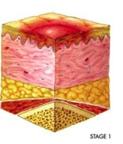
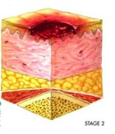
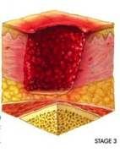
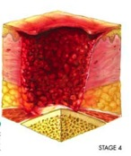
WHI Wound Care: Acute Need
Pressure ulcers induced by continuously applied, excessive pressure to tissue
Pressure ulcers lead to:
Pain, disfigurement, slow recovery
60,000 deaths annually
Longer hospital stays (currently accounts for over 2.5 million Medicare hospital days in US)
No evidence-based detection method available
Stage
1
Stage 2
Stage
3
5
Stage
4

Slide 6
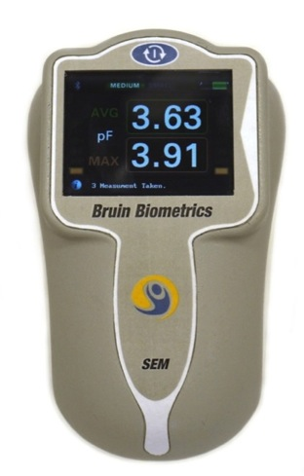
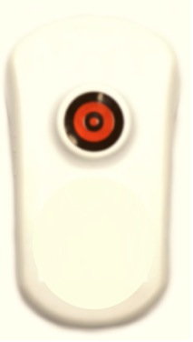
WHI Wound Care Innovation
Wireless Health Solution: SEM Scanner:
First evidence based pressure ulcer detection system
Interrogation of tissue dielectric properties
Detects subepidermal moisture (SEM) and wound state
Contract manufacturing underway
SEM Scanner
Pressure Ulcer Detection

Slide 7
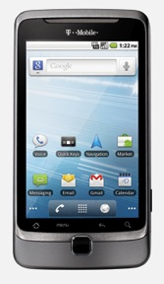
WHI Signal Search Engine: Big Data
Classification Analytics
Motion Sensing
UCFit
Physiological Sensors
Wound Care Devices
Consumer Devices
Data
Transport
Signal Search Engine
Sensors
Smartphone or PC
Data Archive
Android
Gateway
Wireless Health
Sensor Fusion Toolkit
Processing
Guidance
User
Web and Media
Browser
Messaging
Web Services
Media
Fax
UCLA Mednet
Patient Information
Device registration
Training information

Slide 8
WHI Wireless Orthopaedics Mission and Solution
Mission
Defined by broad group of experts in orthopaedics surgery, biomechanics, and sensing lead by Dr. Fabrizio Billi (UCLA Orthopaedics)
Defined vision and objective for low cost, wearable methods for direct detection of injury, joint degradation, and prosthetic health
Solution
Invention of new sensor systems based on novel combined acoustic emission and motion sensing

Slide 9
WHI Wireless Orthopaedics: Acute Need
Orthopaedics monitoring: injury
Injury diagnostics: All joints including spinal cord
Treatment and rehabilitation
Orthopaedics monitoring: disease
Early detection of osteoarthritis
Spinal cord disorders and origin of pain
Orthopaedic monitoring: prosthetics
Early detection of prosthetic failure
Rehabilitation and intervention guidance

Slide 10
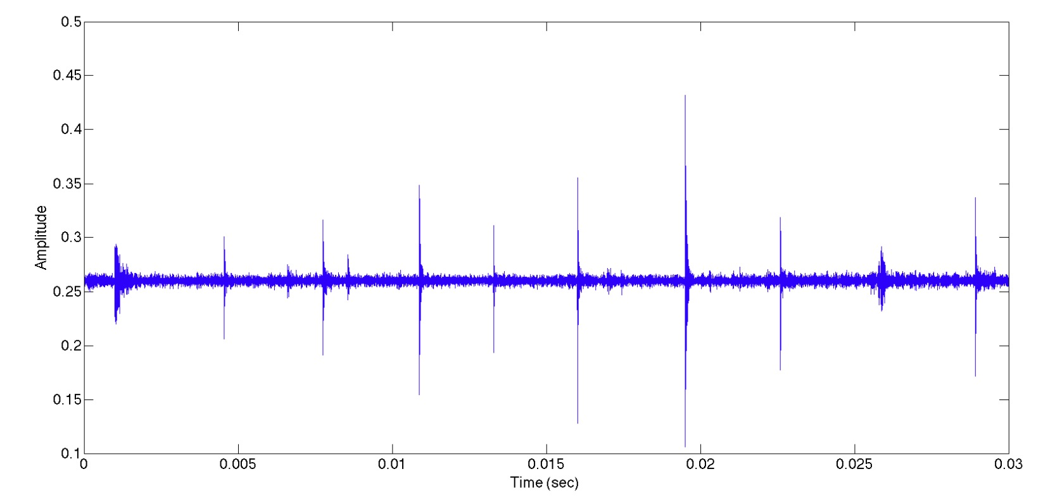
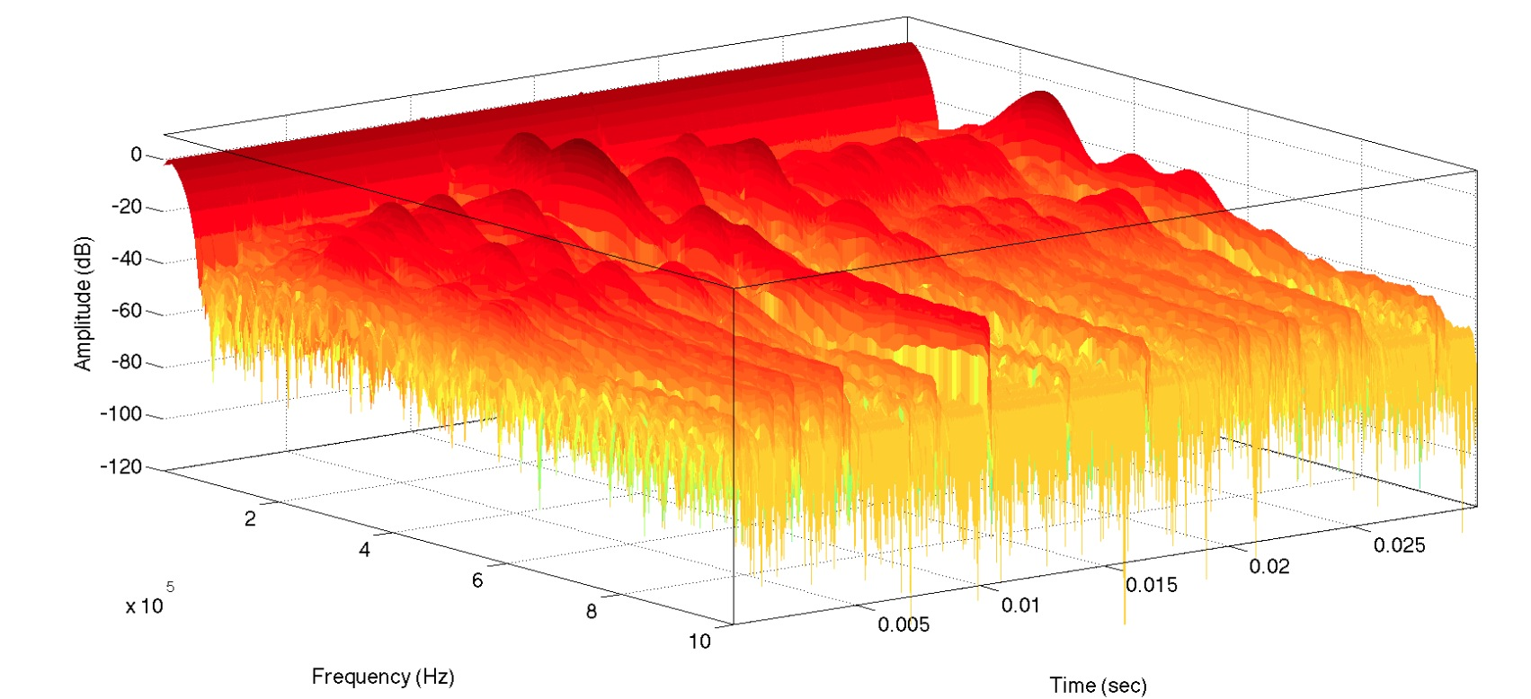
WHI Wireless Orthopaedics System
Wireless Health Solution:
Acoustic emission monitoring
Joint angle monitoring
Combined diagnostics
Wearable Joint Monitor
Wearable sensors at joints
Wireless broadband acoustic sensing
Signal processing for event detection and classification
Clinical trials for ACL and knee and hip replacement underway
Joint Monitoring Signal
Joint Monitoring Spectrogram

Slide 11
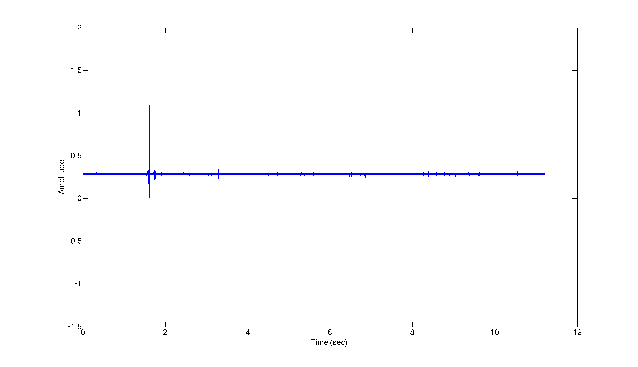
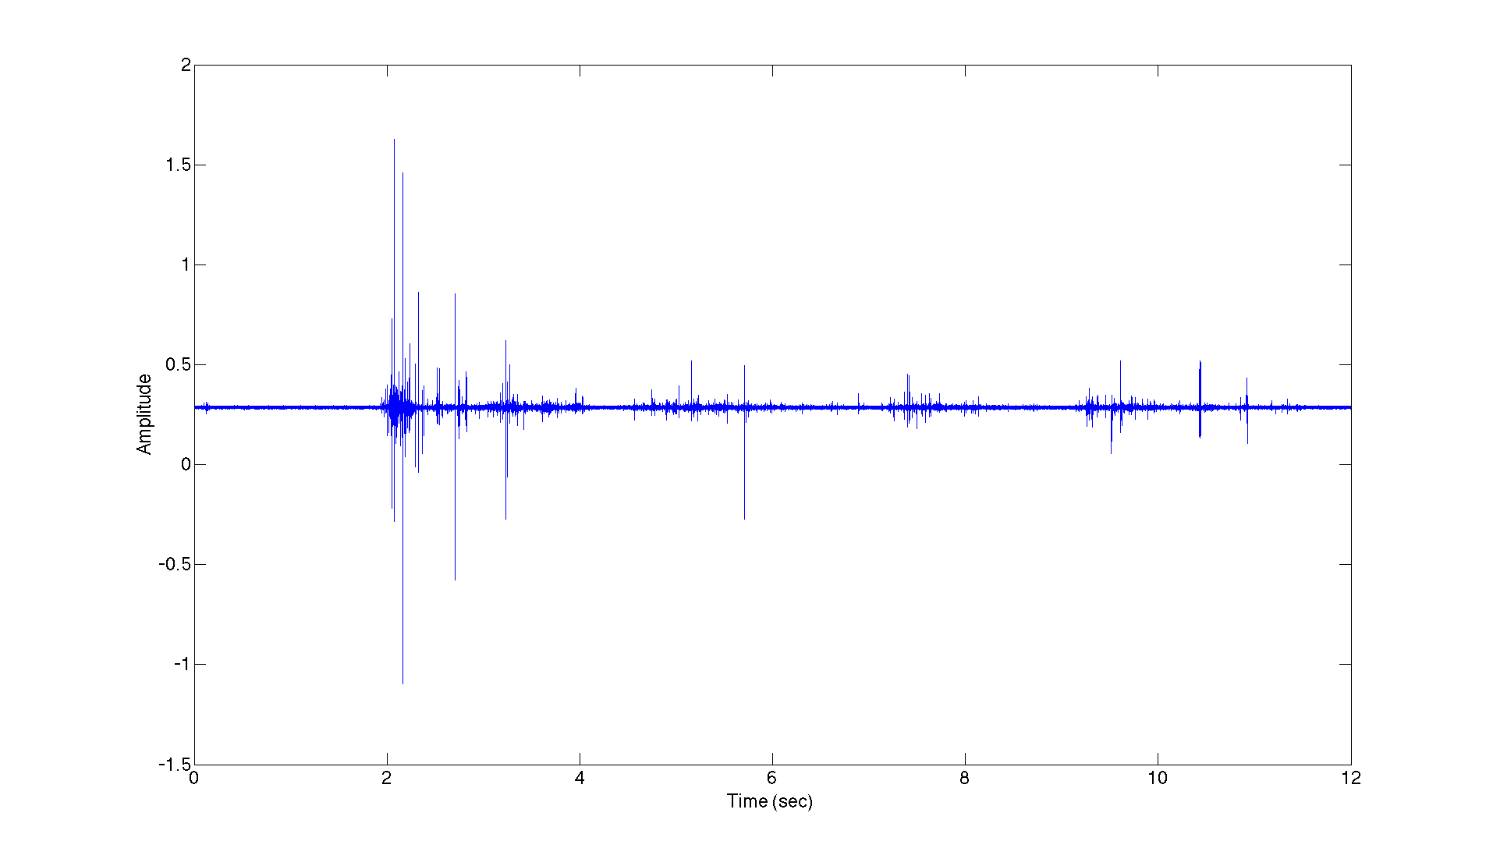
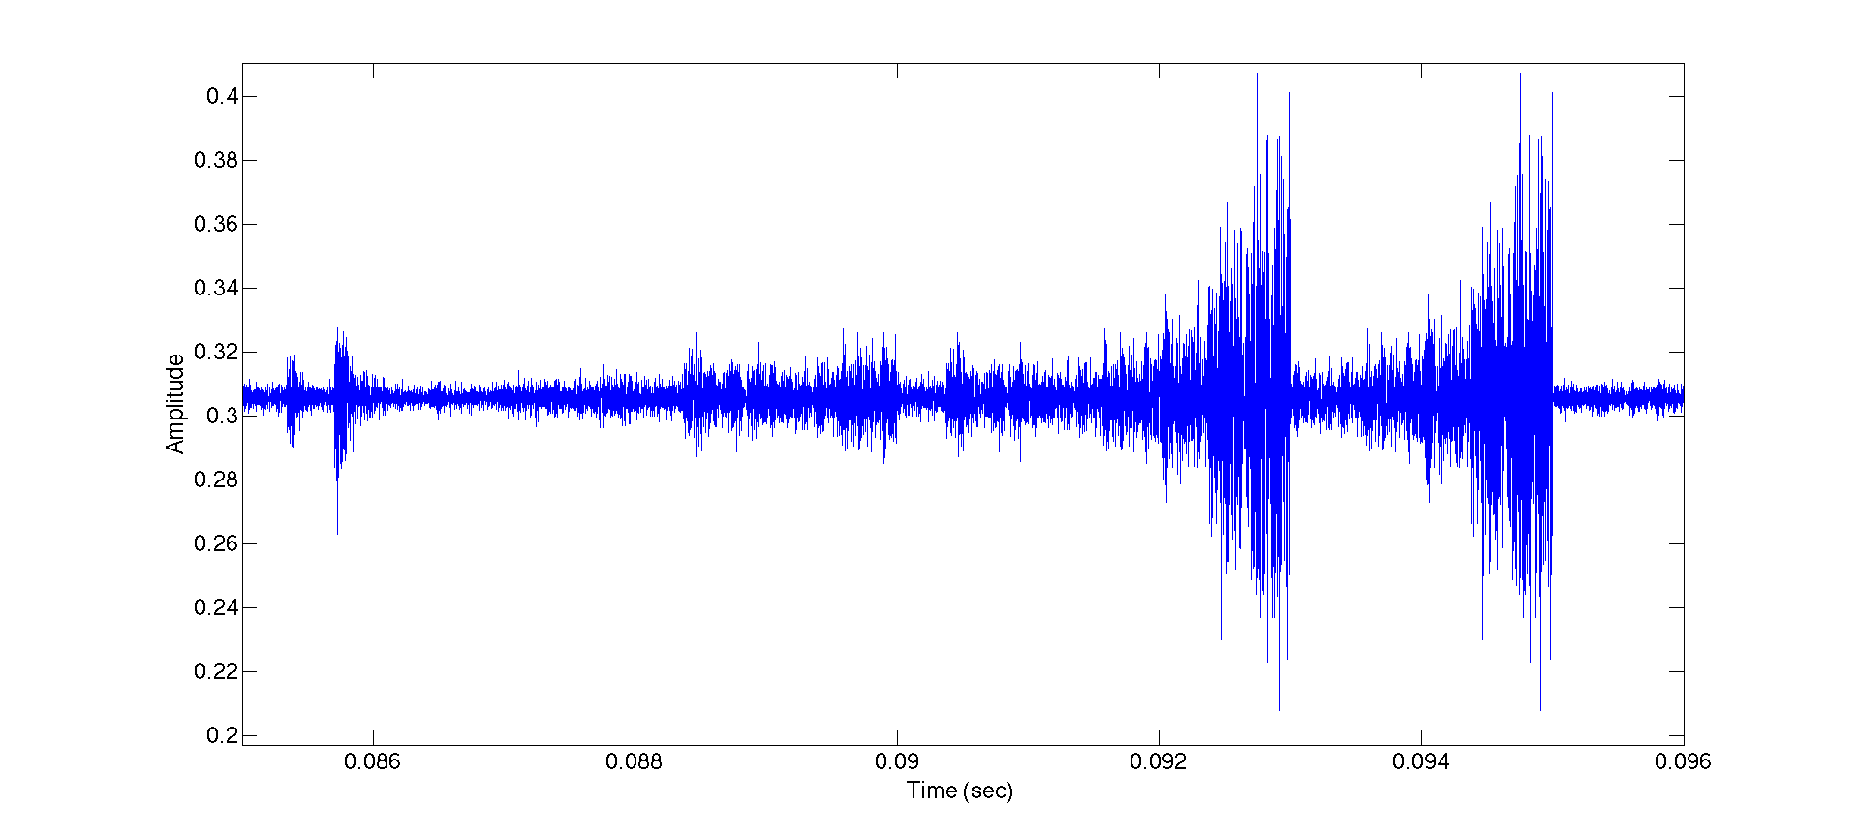
Joint Monitoring Signal Survey: Spatially Resolved, Event Resolved, Joint Load Resolved
Tibia Plateau
Patella
Tibia Plateau Event

Slide 12
WHI Digestive Diagnostics Mission and Solution
Mission
Defined by Dr. Brennan Spiegel (Section Chief for Outcomes Research at the UCLA Divisions of Digestive Diseases)
Defined vision and objective for constantly vigilant, wearable, low cost, digestive disease diagnostic system
Solution
New sensor systems and software for direct analysis of abdominal acoustic signals
International diagnostic service capability

Slide 13
WHI Digestive Diagnostics: Acute Need
Population Impact: 70 million Americans
Mortality: 9.8 percent of all deaths, 236,000
Hospitalization: 9 percent of all admissions
Diseases include inflammatory bowel disease, irritable bowel syndrome, diverticular disease,
Monitoring requires constantly vigilant expert or invasive and high risk imaging procedures

Slide 14
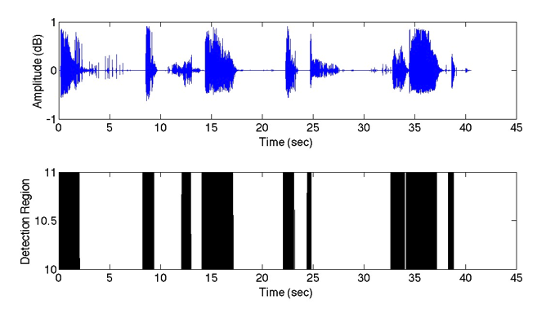
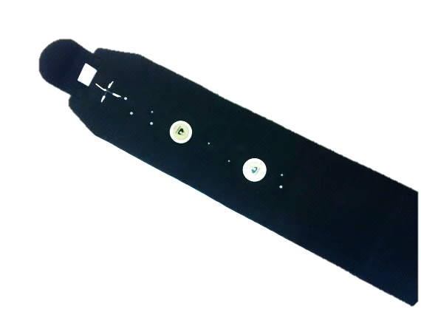
WHI Digestive Diagnostics System
New wireless system
Wearable abdominal signal imaging belt
Operation successful
Stomach, small and large intestine
Product
Low cost, worldwide
Trials
VA and UCLA Reagan Hospital underway
Abdominal Acoustic Signals
Wearable
Abdominal Acoustic Monitor

Slide 15
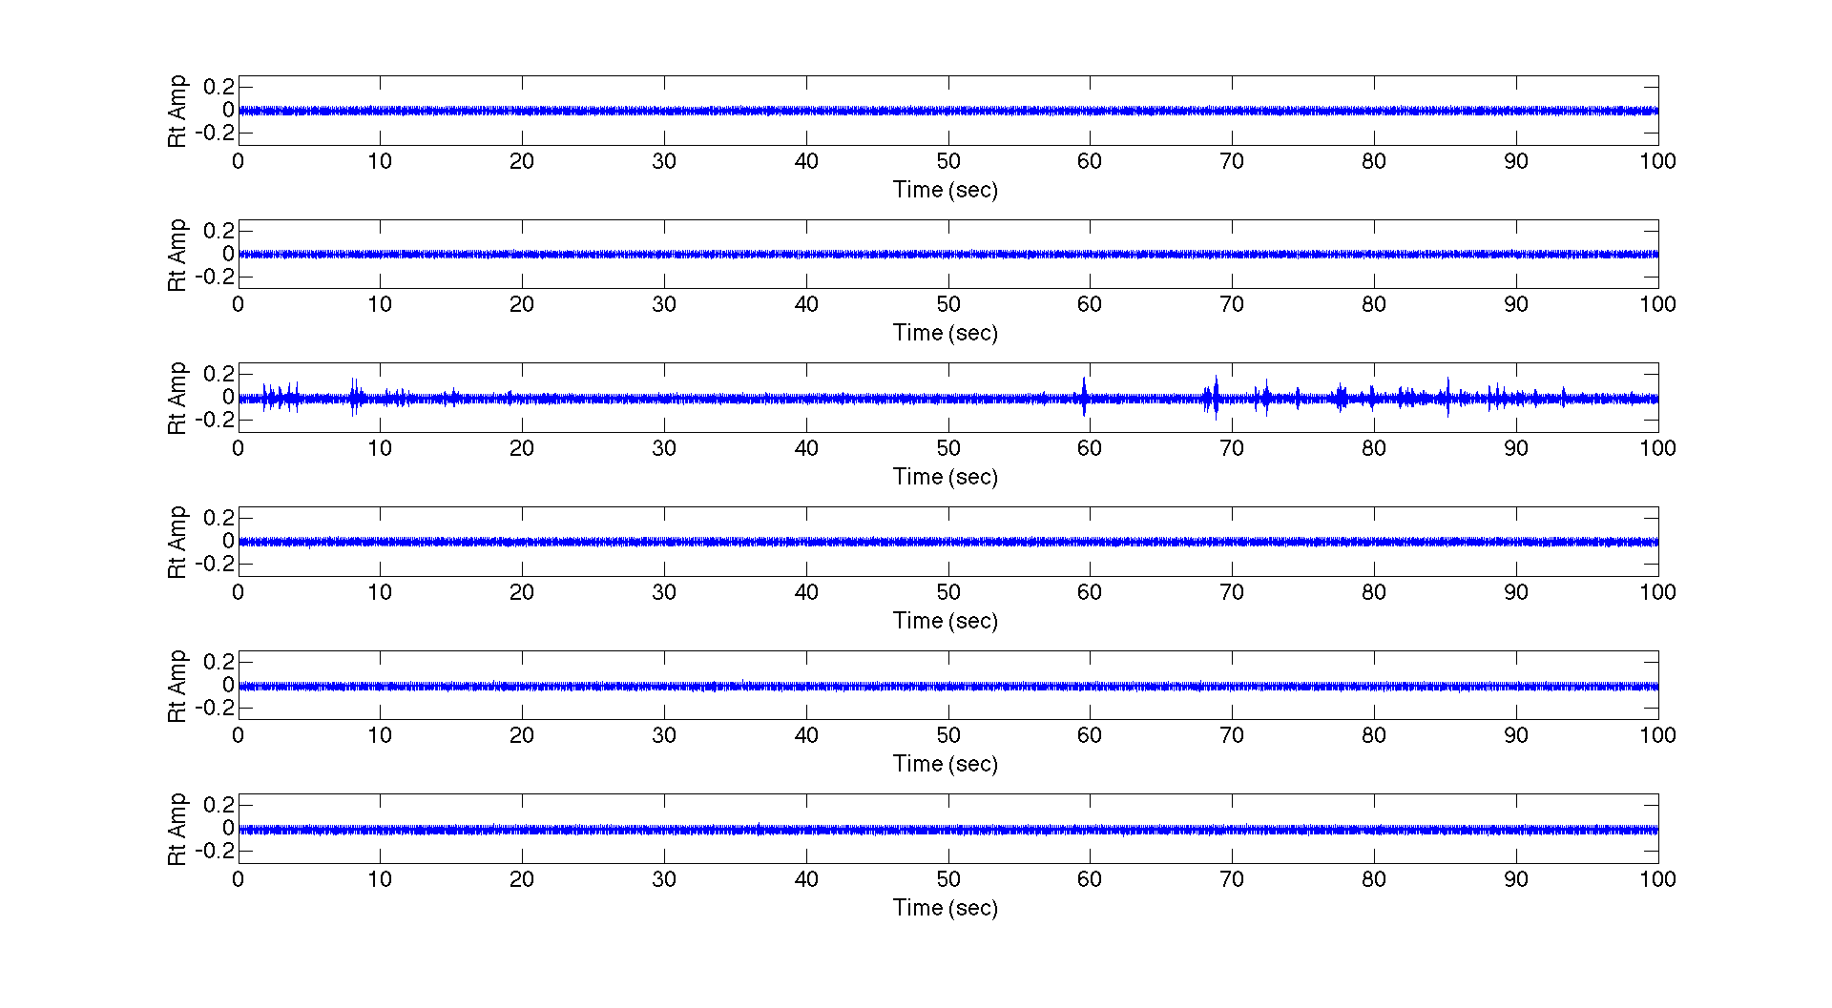
Signal Record for Subject with Ileus Condition

Slide 16
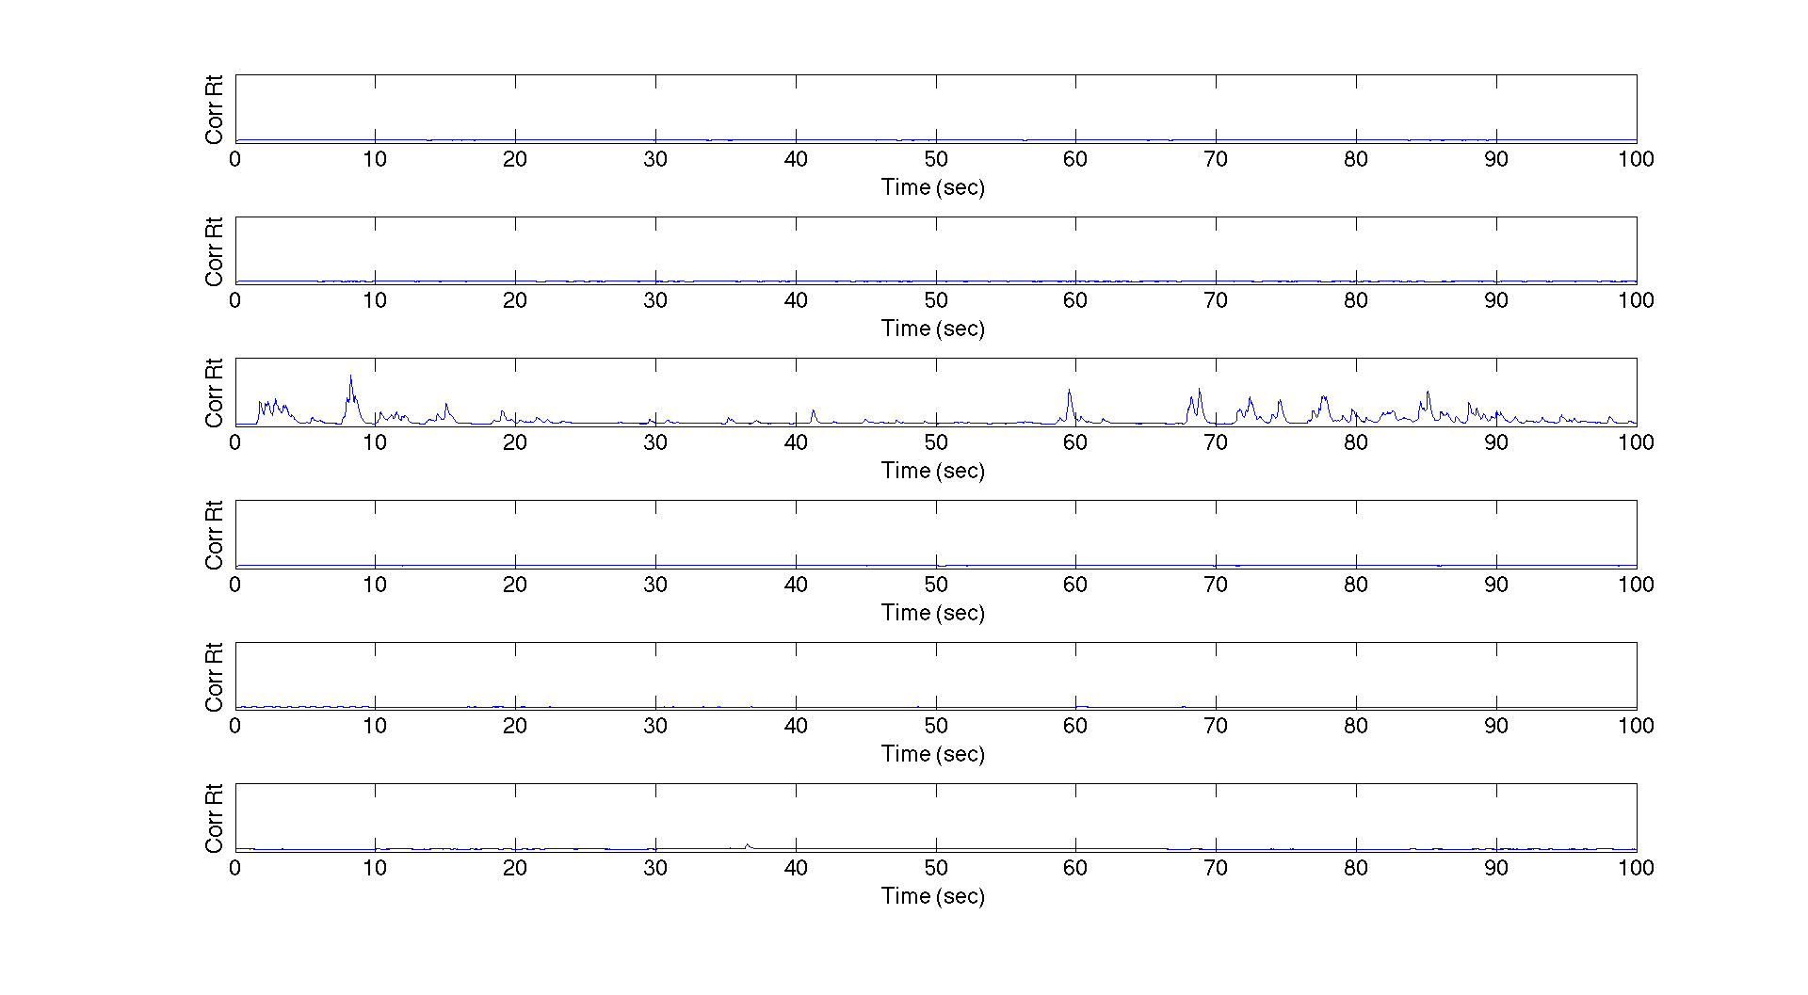
Event Record for Subject with Ileus Condition

Slide 17
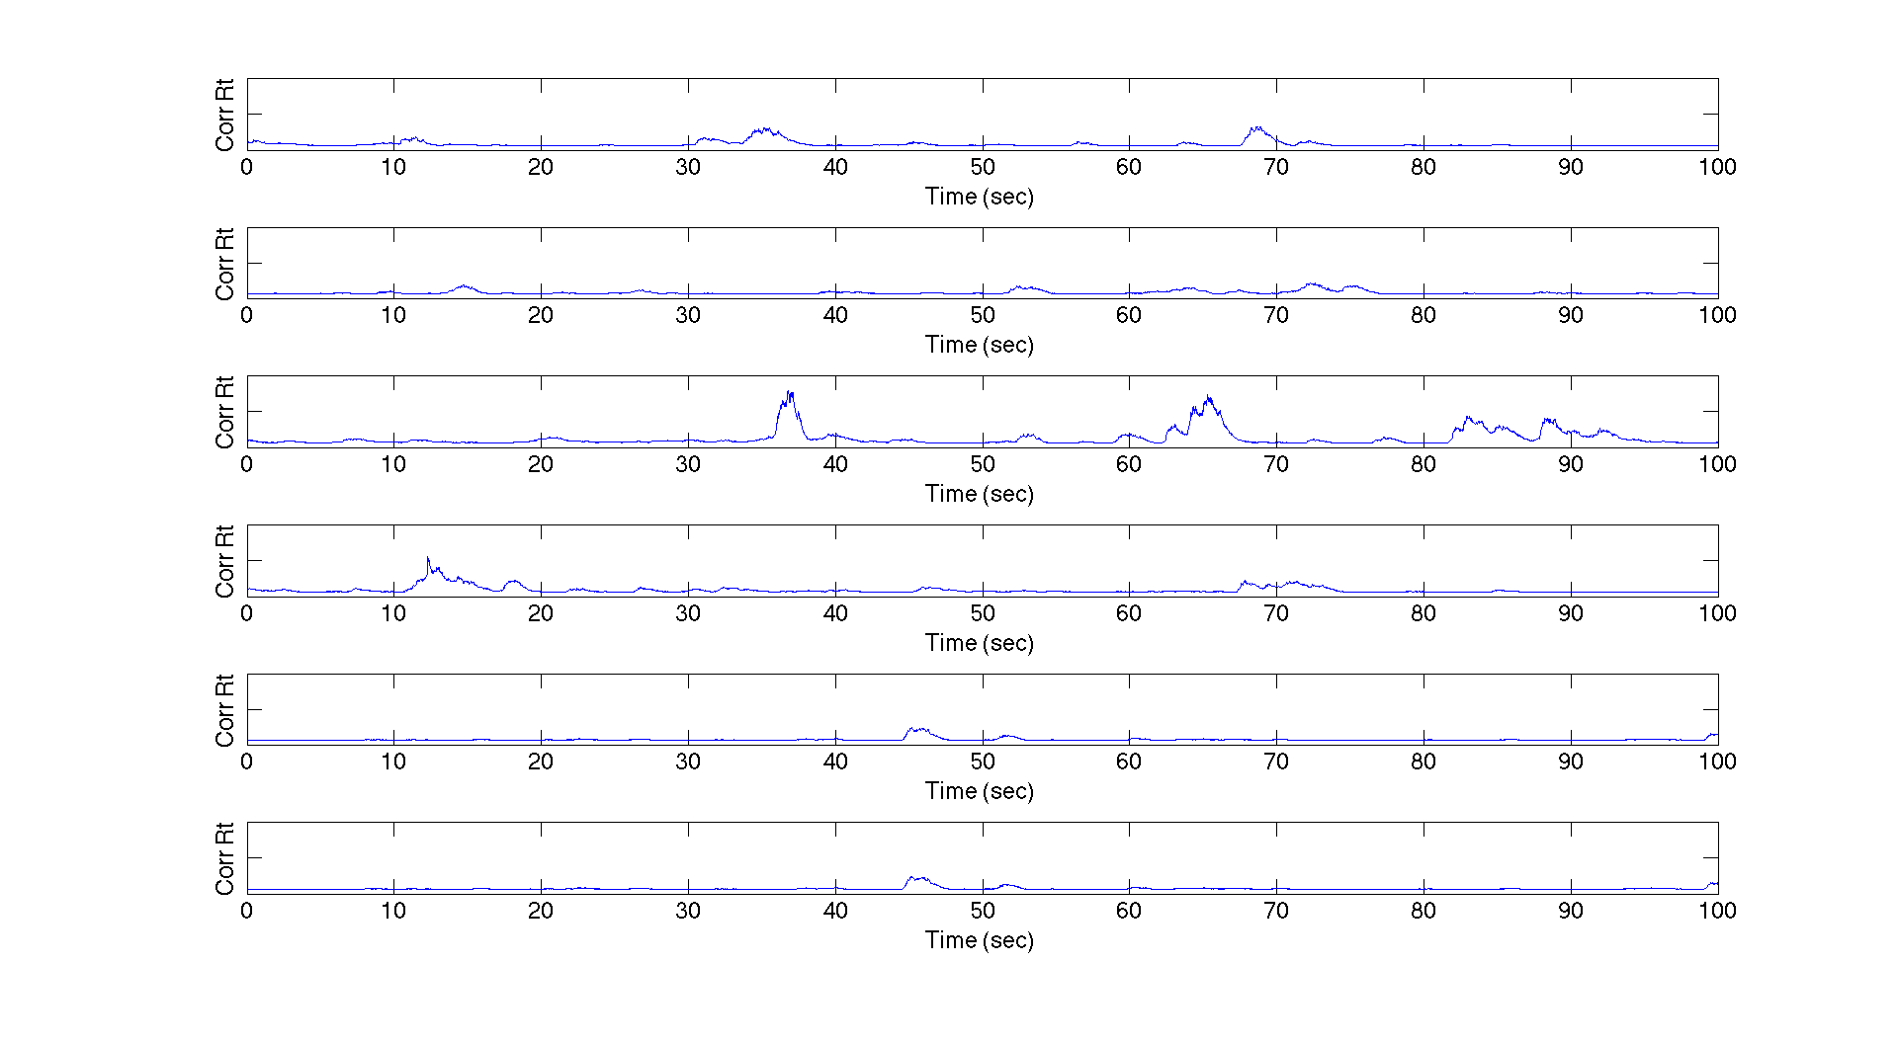
Event Record for Subject Recovering from Ileus Condition

Slide 18
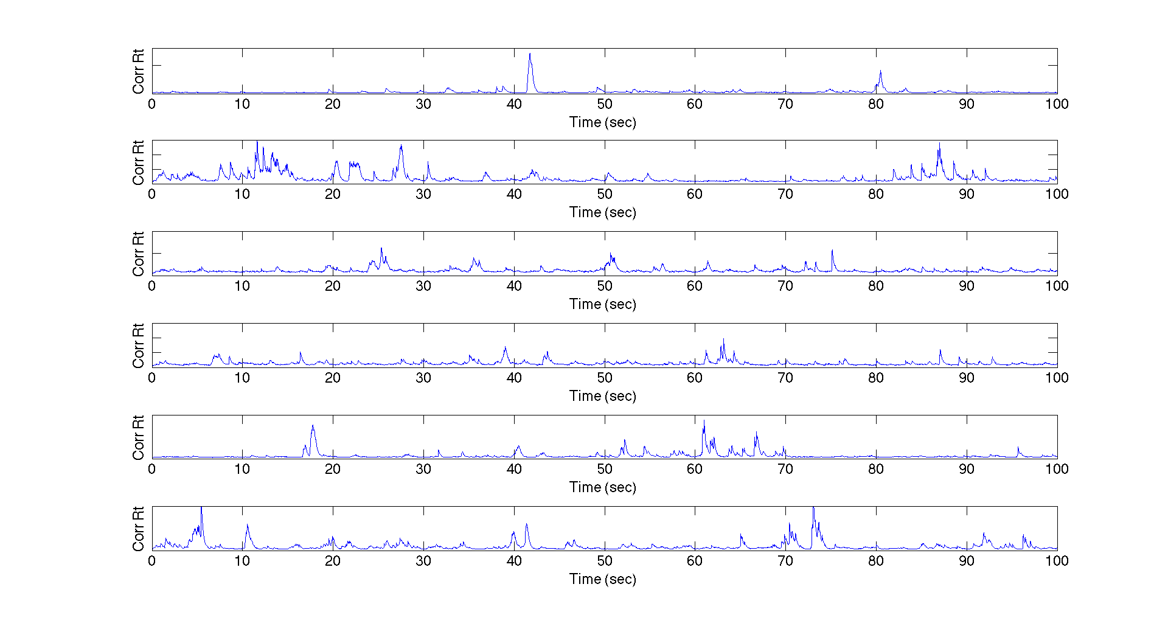
Event Record for Healthy Subject

