Slide 1
How to Build Stakeholder Engagement into Studies
Wendy Slusser, MD, MS
Associate Clinical Professor, UCLA Schools of Medicine and Public Health
Medical Director, Mattel Children’s Hospital UCLA, Fit for Health Program

Slide 2
Objectives
Identify 3 strategies to build stakeholder engagement into studies.
Identify 3 advantages to engage stakeholders into your studies.

Slide 3
Who are the Stakeholders?
Organizations & Institutions
Community/Neighborhood
Media
Law
Insurers
Home Visitation
Friends/Family
Parent, Infant, Child
Coworkers
Fathers
Public Parks
Health Care Providers
Child Care
Popular Culture
Neighbors
Friends
Hospitals
Family
Employer
Public Education
Lactation Specialists
Professional Education
Notes:
Who are the stakeholders?

Slide 4
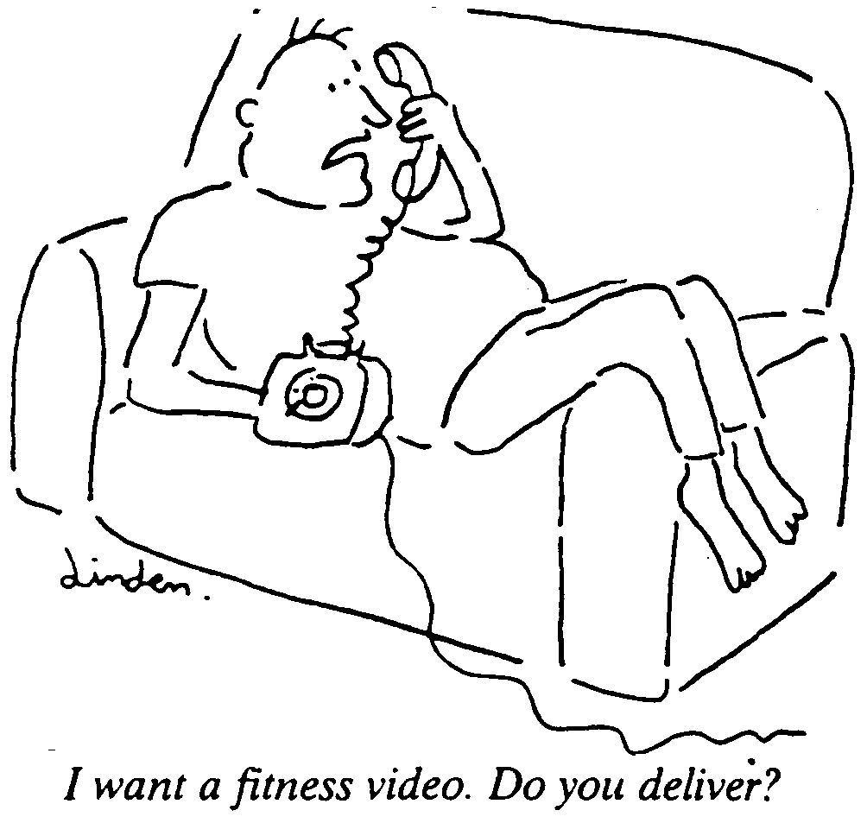
Motivation – it’s complicated!
Notes:
4

Slide 5
Advantages to Building Stakeholder Engagement into Studies
A community-based, capacity-building approach that aims to promote:
sustainable skill development,
strengthen communities
increase the ability of individuals to effectively address and improve health outcomes.
From: de Silva-Sanigorski et al. BMC Public Health 2010, 10:65; Smith A, Coveney J, Carter P, Jolley G, Laris P. Health Promotion International 2004, 19(3):327-334; NSW Health: A Framework for Building Capacity to Improve Health. Edited by Department NSWH. North Sydney 2001.
Notes:
From: de Silva-Sanigorski AM, Bolton K, Haby M, Kremer P, Gibbs L, Waters E, Swinburn B Scaling up community-based obesity prevention in Australia: Background and evaluation design of the Health Promoting Communities: Being Active Eating Well initiativeBMC Public Health 2010, 10:65; Smith A, Coveney J, Carter P, Jolley G, Laris P: The Eat Well SA project: an evaluation-based case study in building capacity for promoting healthy eating. Health Promotion International 2004, 19(3):327-334; NSW Health: A Framework for Building Capacity to Improve Health. Edited by Department NSWH. North Sydney 2001.

Slide 6
A Community-based, Capacity-building Approach
Can influence the underlying social and economic determinants of health in a:
flexible,
sustainable,
equitable
safe manner
From: de Silva-Sanigorski et al. BMC Public Health 2010, 10:65; Sanigorski AM, et al. Journal Of Obesity (2005) 2008, 32(7):1060-1067.

Slide 7

Strategies to Engage Stakeholders
  Motivational Interviewing
    “... method of communication rather than a set of techniques. It is not a bag of tricks for getting people to do what they don’t want to do; rather, it is a fundamental way of being with & for people - a facilitative approach to communication that evokes change.”
From: Miller & Rollnick 2002
  Asset Mapping and Mobilization
    From: www.abcdinstitute.org
  Community Based Participatory Research
    “A key tenet of CBPR is the identification of assets and facilitators of health. Resulting interventions are more likely to leverage individual, institutional and community assets and provide salient knowledge, skills and resources to the target population than traditional deficity-focused models
    From: Davison KK etal 2013 International J of Behcioral Nutritoin and Physical Activity.

Slide 8
Capacity-Focused Community Development
• Asset mapping is an inventory of the
community’s treasure chest.
  In the process of this inventorying, important relationships are developed.
  asset mapping is NOT an action step
Notes:
From: McKnight Model—Asset Mapping

Slide 9
Capacity-Focused Community Development
Asset mobilization IS an action step.
Mobilizing assets for collective action requires organizing and harnessing the relationships that exist within the community
Often Asset Mapping lends itself to Asset Mobilization

Slide 10
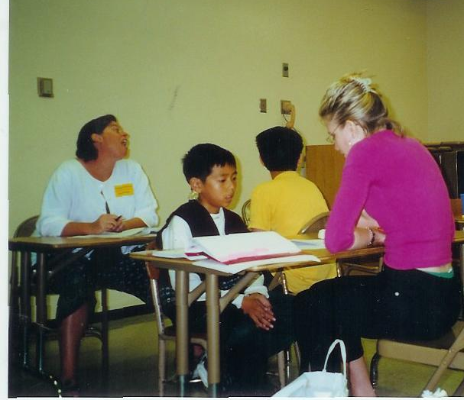
Asset Mapping Asset Mobilization Research
Hunger Study
Salad Bars in LAUSD
Nutrition Friendly Schools
Preschool Intervention to prevent pediatric overweight
Notes:
Through observation and asking questions many research questions were derived.

Slide 11
Hunger Study
A cross sectional survey of children in 14 randomly selected LAUSD elementary schools in 1998.
Nine hundred and nineteen children were measured and interviewed.
More than 35% of the sample was classified as being at risk for overweight or overweight according to body mass index.
The planning, design and data analysis were carried out in collaboration with key LAUSD policy-makers.
From: Slusser WM, Cumberland W, Winham D,Browdy B, Neumann C (2005). Public Health Nutrition: 8:141-148.

Slide 12
Hunger Study Stakeholder Engagement
Identified policy-makers in LAUSD including the Deputy Food Service Director, the principals, School Board Members, Staff, and LAUSD Medical Director.
Maintained on-going communication throughout the study’s planning, implementation and data analysis phases.
Held periodic meetings, asked for their suggestions and input in the research design and fed back the results during the data analysis.
From: Slusser WM, Cumberland W, Winham D,Browdy B, Neumann C (2005). Public Health Nutrition: 8:141-148.

Slide 13
Hunger Study Stakeholder Engagement
Gave back to the schools and communities that participated:
  Launched Salad Bars in 3 of the 14 schools.
  Provided support for SPARK physical education training for teachers in 3 of the 14 schools.
  Supported the inception of the Nutrition Network Program.
  Participated in the early community meetings that helped launch advocacy organization headed by Harold Goldstein.
From: Slusser WM, Cumberland W, Winham D,Browdy B, Neumann C (2005). Public Health Nutrition: 8:141-148.

Slide 14
Hunger Study: Lessons Learned
Early and on-going participation with key stakeholders facilitates the process of action through research.
The academic and policy-maker collaboration facilitates program implementation that responds to the health needs within individual school districts.
Giving back to organizations, individuals and communities where you conduct research leads to strong future collaborations.
From: Slusser WM, Cumberland W, Winham D,Browdy B, Neumann C (2005). Public Health Nutrition: 8:141-148.

Slide 15
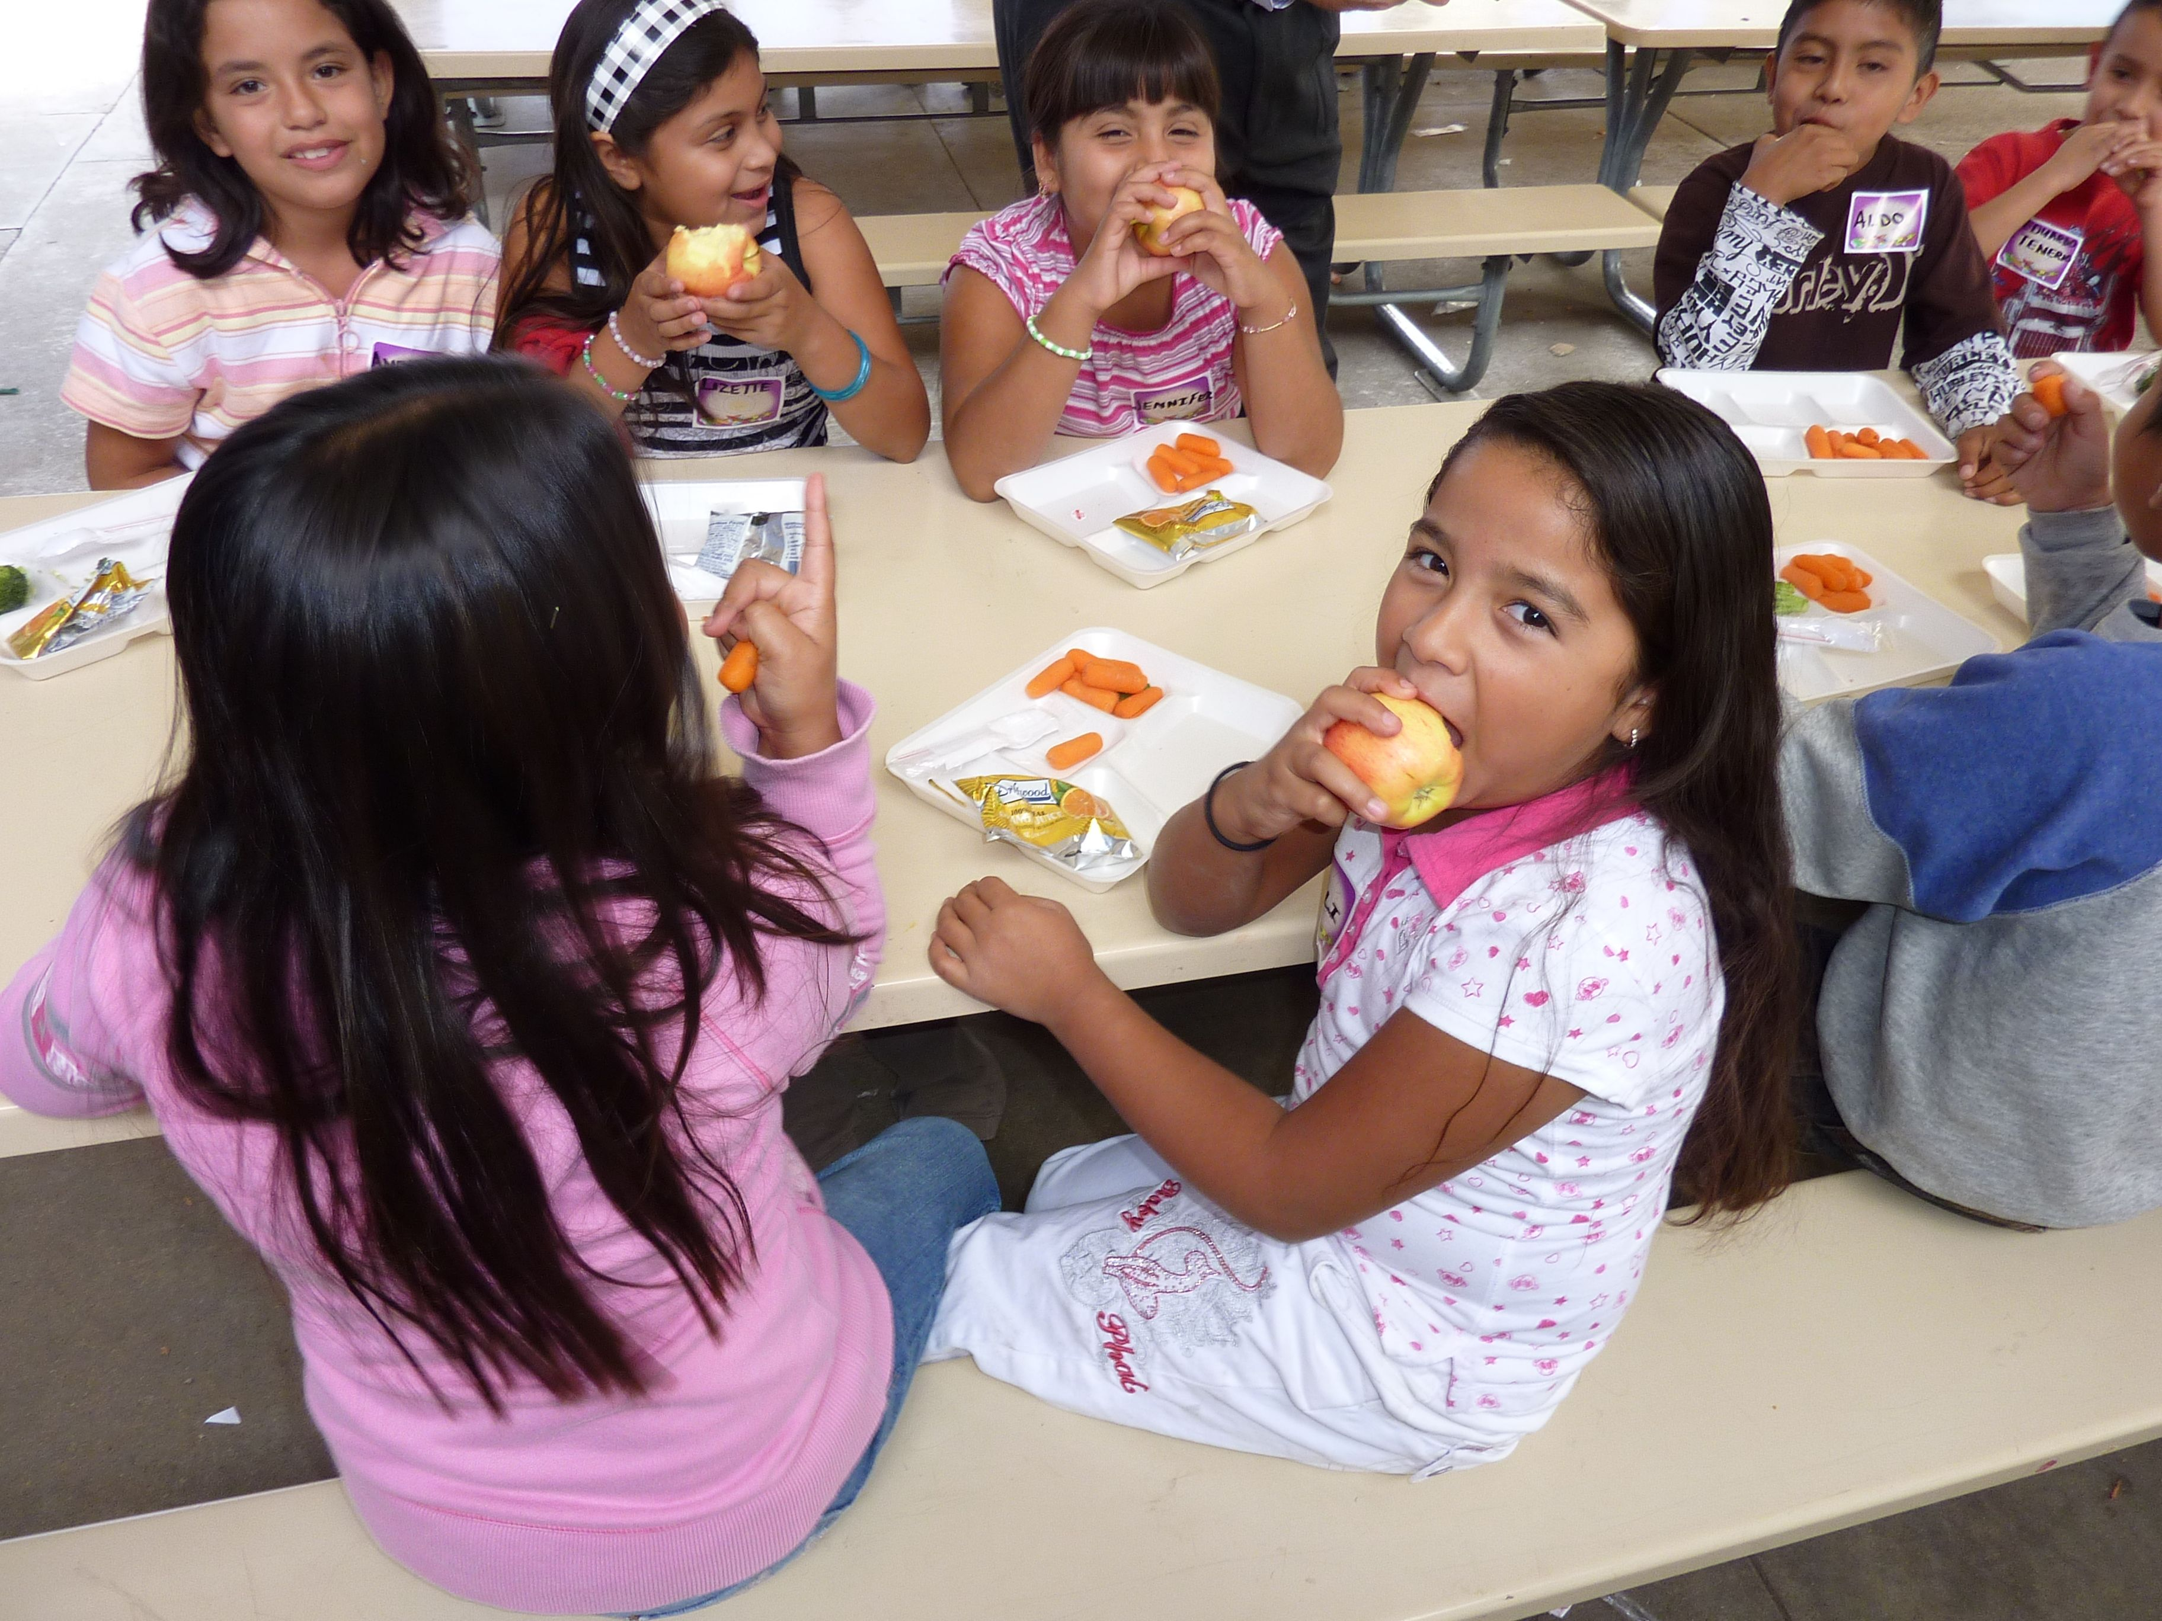
Asset Mapping Asset Mobilization Research
Hunger Study
Salad Bars in LAUSD
Nutrition Friendly Schools
Preschool Intervention to prevent pediatric overweight
Notes:
Through observation and asking questions many research questions were derived.

Slide 16
Salad Bar Evaluation 2000
There was a significant increase in frequency (2.97 to 4.09, P , 0.001) of FV consumed after the salad bar was introduced in the school lunch program among the LAUSD elementary school children studied in this cross-sectional sample.
From: Slusser WM, Cumberland W, Browdy B, Lange L and Neumann C (2007). Public Health Nutrition: 10 (12): 1490-1496

Slide 17
Salad Bar Evaluation 2005
There was a significant increase in nutrition knowledge, (p< .05), female healthy food preferences (p< .05), consumption of 0.77 fruit and vegetable servings during school lunch (p= 0.00), and decrease in consumption of 94 calories during school lunch (p=0.0001) among the LAUSD predominately Latino LAUSD elementary children attending the intervention schools receiving a salad bar and nutrition education in contrast to the comparison schools.
From: Slusser W, Sareen H, Dhavanthari L, Lavacarre S, Renenger K, Neumann C. (2008 and 2009), NICHQ Conference, Miami Florida and PAS, Baltimore, Maryland

Slide 18
Salad Bar Evaluation 2011
There was no significant increase in FV consumption, but there was an associated with improved vegetable intake with participation in the FV bar at follow-up among LAUSD elementary school students before and after installation of a FV bar and provision of physical activity tools.
From: Slusser W et al, Southern CA Public Health Association, Poster, 2012.

Slide 19
Salad Bar Studies Lessons Learned
Continued early and on-going collaboration with key stakeholders helped to facilitate the research and the process of action through research.
  Examples of participation: spoke at school board meetings, congressional hearings and provided study write ups.
  Provided cash incentives to schools, cafeteria managers, and provided funding for salad bar equipment (total over the years of: $80,000).
From: Slusser WM, Cumberland W, Browdy B, Lange L and Neumann C (2007). Public Health Nutrition: 10 (12): 1490-1496.

Slide 20
Asset Mapping Asset Mobilization Research
Hunger Study
Salad Bars in LAUSD
Nutrition Friendly Schools
Preschool Intervention to prevent pediatric overweight
Notes:
Through observation and asking questions many research questions were derived.

Slide 21
Nutrition Friendly Schools
The concept for the NSFC model came about as part of an ongoing collaboration between the LAUSD, Nutrition Network and UCLA.
Developed from an asset-based strategy for engaging school-community stakeholders to become actively involved in changing the nutrition and physical activity environment of their schools.
From: Vecchiarelli, Prelip, Slusser, Weightman, & Neumann, 2005; Prelip M, Slusser W, Lange L, Vecchiarelli S and Neumann C (2010) Health Promot Pract; (11) 54-61.­

Slide 22
Nutrition Friendly Schools
The model combined the eight environmental components of the Coordinated School Health Model with the accreditation approach of the Baby Friendly Hospital Initiative to provide school-community stakeholders the overarching planning and evaluation structure needed to improve nutrition and physical activity at their schools.
From: Vecchiarelli, Prelip, Slusser, Weightman, & Neumann, 2005; Prelip M, Slusser W, Lange L, Vecchiarelli S and Neumann C (2010Health Promot Pract; (11) 54-61.

Slide 23
Nutrition Friendly Schools Results and Lessons Learned
Engagement of the school stakeholders led to positive changes in the schools: All of the schools developed action plans to implement the full 15-step model. All of the schools made progress from their baseline measure. One school met all of the 13 steps that were achievable over the course of this study.
The engagement of the wellness coordinator early on in the study did not take place and may be one of the reasons this model has not been adopted in the District.
From: Vecchiarelli, Prelip, Slusser Weightma, & Neumann, 2005; Prelip M, Slusser W, Lange L, Vecchiarelli S and Neumann C (2010). Health Promot Pract; (11) 54-61.

Slide 24
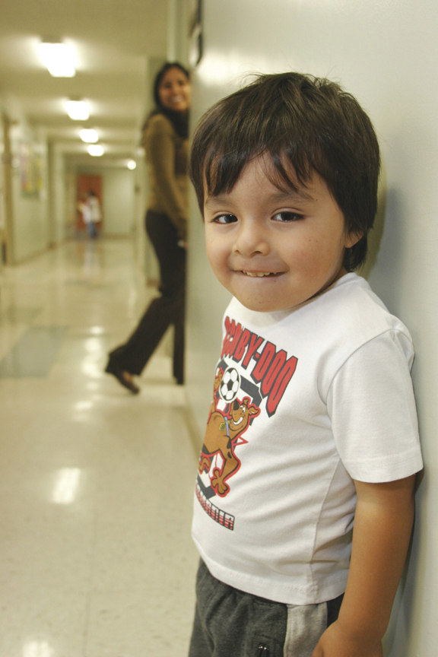
Asset Mapping Asset Mobilization Research
Hunger Study
Salad Bars in LAUSD
Nutrition Friendly Schools
Preschool Intervention to prevent pediatric overweight
Notes:
Through observation and asking questions many research questions were derived.

Slide 25
Preschool Intervention to prevent pediatric overweight
Objective: To promote the health and wellness of preschool children in Los Angeles through the promotion of positive parenting, healthy nutrition and optimal physical activity.
From: Slusser WM, Frankel F, Robison K, Fischer H, Cumberland WG, Neumann C. (2012); Journal of Pediatric Obesity 8(1):52-59.

Slide 26
Preschool Intervention to prevent pediatric overweight
A randomized controlled study evaluating a culturally sensitive parent-training intervention consisting of 1.5 hour classes held once a week for 7 weeks with 2 booster sessions given 1 month and 2 months apart.
From: Slusser WM, Frankel F, Robison K, Fischer H, Cumberland WG, Neumann C. (2012) Pediatric Overweight Prevention through a Parent Training Program for 2-5 year old Latino Children. Journal of Pediatric Obesity 8(1):52-59.

Slide 27
Preschool Intervention to prevent pediatric overweight
At one year follow-up children’s z scores were significantly better compared to children whose parents did not take the parenting classes.
Translated to a Promotora Model by one of the research sites with additional funding support from the UCLA Chancellor’s office (project initiated by the community site).
From: Slusser WM, Frankel F, Robison K, Fischer H, Cumberland WG, Neumann C. (2012) Pediatric Overweight Prevention through a Parent Training Program for 2-5 year old Latino Children. Journal of Pediatric Obesity 8(1):52-59.

Slide 28
Preschool Intervention to prevent pediatric overweight Lessons Learned
Parent Training Classes are making a positive impact on the family and child’s nutrition and physical activity behaviors.
Interventions for parents of young children should take place within the community they live and/or gather on a regular basis.
Interventions that combine high priority issues such as parenting with nutrition and physical activity promotion are promising in promoting health and wellness among low-income families.
From: Slusser WM, Frankel F, Robison K, Fischer H, Cumberland WG, Neumann C. (2012) Pediatric Overweight Prevention through a Parent Training Program for 2-5 year old Latino Children. Journal of Pediatric Obesity 8(1):52-59.

Slide 29
Preschool Intervention to prevent pediatric overweight Lessons Learned
Working on adapting it to different modes of delivery methods such as tele-health and integrating it into Headstart programs.
From: Slusser WM, Frankel F, Robison K, Fischer H, Cumberland WG, Neumann C. (2012) Pediatric Overweight Prevention through a Parent Training Program for 2-5 year old Latino Children. Journal of Pediatric Obesity 8(1):52-59.

Slide 30
Preschool Intervention to prevent pediatric overweight Lessons Learned
Engaging low-income minority parents with young children in preventive parenting interventions is challenging because of competing time commitments and priorities, unstable schedules, and lack of transportation.
From: Winslow EB, Bonds D, Wolchik S, Sandler I, Braver S. Predictors of Enrollment and Retention in a Preventive Parenting Intervention for Divorced Families. J Primary Prevent 2009; 30:151–172.

Slide 31
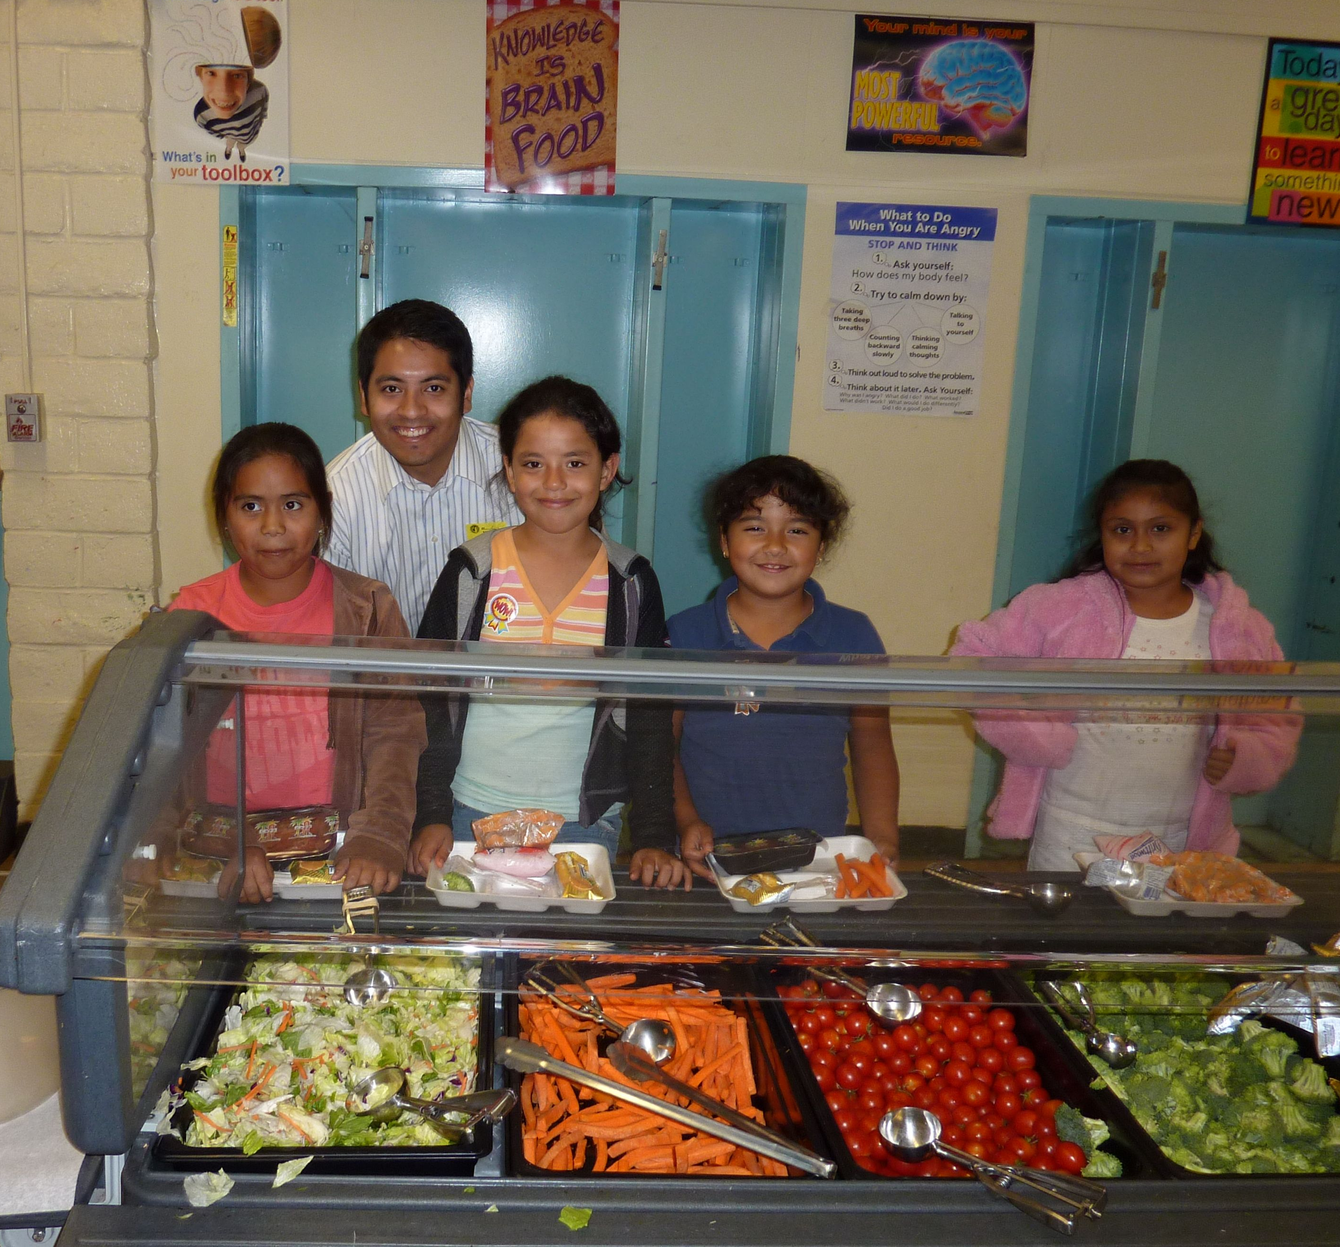
Asset Mapping Asset Mobilization Research
Policy
Notes:
Research and Policy are often interrelated or at least you hope they are! And they evolve from reflection and taking action.
One research project I am particular proud of is the salad bar study that has provided evidence for federal legislation for increasing fruit and vegetable offerings during the school lunch program and has helped trigger Michelle Obama’s Let’s Move Salad Bars to Schools initiative.

Slide 32
Asset Mapping Asset Mobilization Research
Policy
IOM Report: School Meals: Building Blocks for Healthy Children, 2010.
Two Federal bills introduced by Congressman Sam Farr in 2009 (H.R. 4333, Children’s Fruit and Vegetable Act) and Senator Barbara Boxer in 2010 (S. 3144)
Let’s Move Salad Bars to Schools, 2010
LAUSD Obesity Prevention Motion 2003
Notes:
Research and Policy are often interrelated or at least you hope they are! And they evolve from reflection and taking action.
One research project I am particular proud of is the salad bar study that has provided evidence for federal legislation for increasing fruit and vegetable offerings during the school lunch program and has helped trigger Michelle Obama’s Let’s Move Salad Bars to Schools initiative.

Slide 33
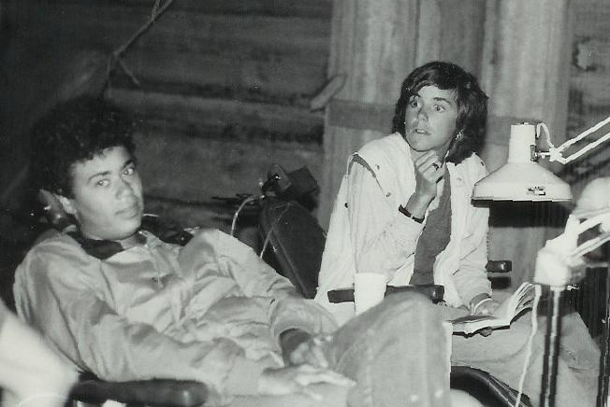
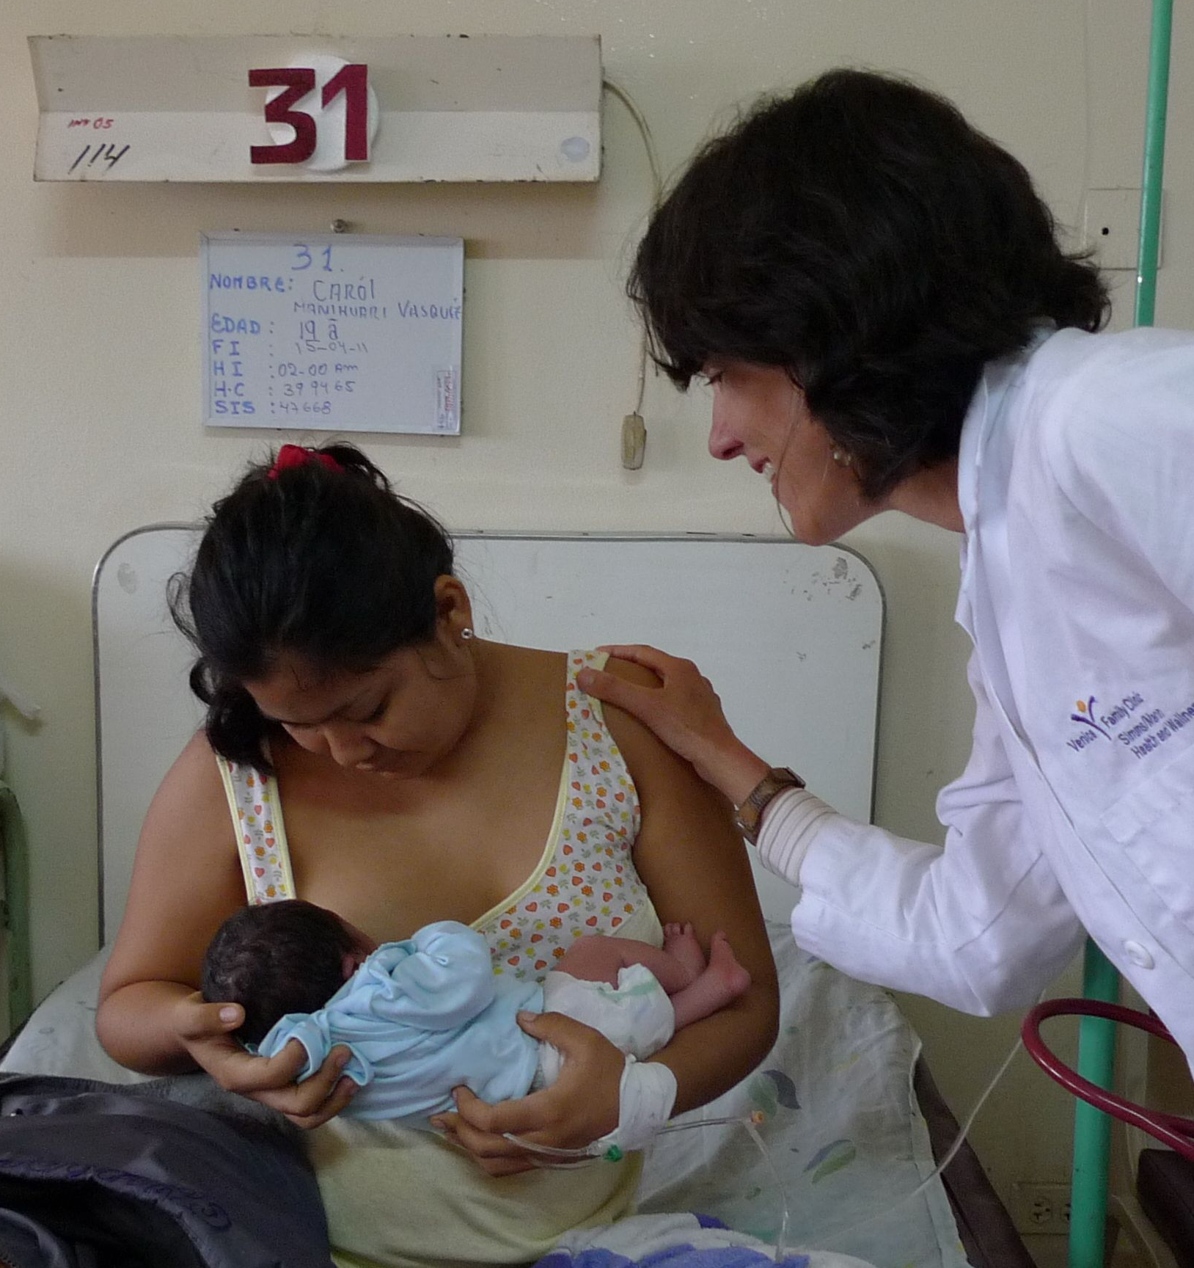
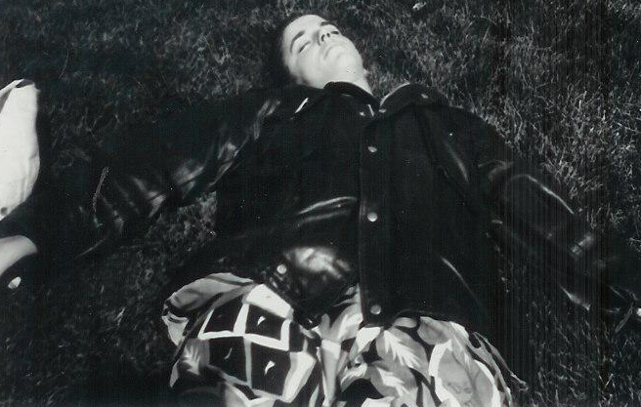
Personal Lessons Learned
Listening
Observing
Reflecting
Notes:
Relying on listening I pursued my work as a teacher training teams of University level professors in medicine, nursing, nutrition, and public health so they could teach breastfeeding to their university students from the US and all over the world.

Slide 34
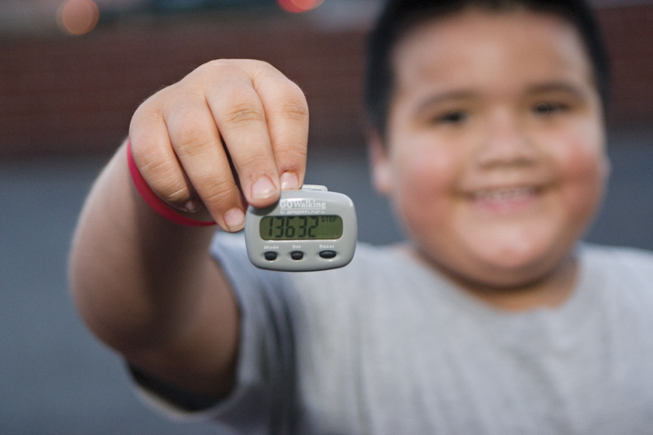
Taking Action Steps!
Notes:
Lessons learned from: listening, observing, reflecting and taking action and how they relate to the evidence in the literature.

Slide 35
What are your Successes and Challenges in Engagement?

Slide 36
With realization of one’s own potential and self confidence in one’s ability, one can build a better world.
Dalai Lama

