Slide 1
Patient-Centered Outcomes Research Institute
Methods Matter: Goals and Content of the First PCORI Methodology Report and Standards
Brian S. Mittman, PhD
August 20, 2012

Slide 2
Outline
PCORI
Origin and Appointments
Resources
Mission
PCORI Methodology Committee & 1st Report
Overview and Development Process
Report Contents
Implementation Plan

Slide 3
PCORI Origin & Appointments
On March 23, 2010, the 111th Congress created PCORI as part of the Patient Protection and Affordable Care Act
(Public Law 111–148)
Board of Governors
Press Release (September 23, 2010)
WASHINGTON, DC– Gene L. Dodaro, Acting Comptroller General of the United States and head of the U.S. Government Accountability Office (GAO), today announced the appointment of 19 members to the Board of Governors for the new Patient-Centered Outcomes Research Institute (PCORI).
Methodology Committee
Press Release (January 21, 2011)
WASHINGTON, DC — Gene L. Dodaro, Comptroller General of the United States and head of the U.S. Government Accountability Office (GAO), today announced the appointment of 15 members to the Methodology Committee of the Patient-Centered Outcomes Research Institute (PCORI).

Slide 4
PCORI Resources
FY 2010 -2012
$210 million from the Patient-Centered Outcomes Research Trust Fund
$150 million from the Patient-Centered Outcomes Research Trust Fund
FY 2013
FY 2014 - 2019
$150 million from the Patient-Centered Outcomes Research Trust Fund
$1 fee per Medicare and private health insurance beneficiary
Estimated at $325 million
$2 fee per Medicare and private health insurance beneficiary
Estimated at $500 million annually

Slide 5
PCORI Mission Statement
The Patient-Centered Outcomes Research Institute (PCORI) helps people make informed health care decisions – and improves health care delivery and outcomes – by producing and promoting high integrity, evidence-based information – that comes from research guided by patients, caregivers and the broader health care community.

Slide 6
Defining Patient-Centered Outcomes Research (PCOR)
Helps people and their caregivers communicate and make informed health care decisions, allowing their voices to be heard in assessing the value of health care options. This research answers patient-centered questions such as:
Expectations
Options
Outcomes
Decisions
“Given my personal characteristics, conditions and preferences, what should I expect will happen to me?”
“What are my options and what are the potential benefits and harms of those options?”
“What can I do to improve the outcomes that are most important to me?”
“How can clinicians and the care delivery systems help me make the best decisions about my health and healthcare?”
6

Slide 7
Board of Governors Composition
The 21 member Board of Governors spans a diverse array of fields and areas of expertise within the Health Care arena.
Federal and State
Public Health
Officials
Patients and
Health Care Consumers
Private
Payers
Board of Governors
Physicians,
Nurses, and Providers
Pharmaceutical, Device, and Diagnostic Manufacturers
Health
Services
Researchers
Caregivers

Slide 8
Board of Governors Composition
MEMBER | TITLE
Eugene Washington, MD, MSc (Chair) | Vice Chancellor of UCLA Health Sciences, Dean of David Geffen School of Medicine at UCLA
Steven Lipstein, MHA (Vice Chair) | President and Chief Executive Officer of BJC HealthCare
Debra Barksdale, PhD, RN | Associate Professor at the University of North Carolina (UNC) at Chapel Hill School of Nursing
Kerry Barnett, JD | Executive Vice President, Corporate Services, Chief Legal Officer, and Ethics and Compliance Officer, The Regence Group
Lawrence Becker | Director of Strategic Partnerships and Alliances for Xerox Corporation
Carolyn Clancy, MD | Director of the Agency for Healthcare Research and Quality
Francis Collins, MD, PhD | Director of the National Institutes of Health
Leah Hole-Curry, JD | Program Director for the Health Technology Assessment (HTA) program of the Washington State Health Care Authority
Allen Douma, MD | CEO, Empower, LLC, and a member of the AARP Board of Directors
Arnold Epstein, MD | John H. Foster Professor & Chair of the Department of Health Policy and Management at Harvard University
Christine Goertz, DC, PhD | Vice Chancellor, Research and Health Policy, Palmer College of Chiropractic
Gail Hunt | President and CEO of the National Alliance for Caregiving
Robert Jesse, MD, PhD | Principal Deputy Under Secretary for Health, Department of Veterans Affairs
Harlan Krumholz, MD | Harold H. Hines, Jr. Professor of Medicine and Epidemiology & Public Health at Yale University School of Medicine
Richard E. Kuntz, MD, MSc | Senior Vice President and Chief Scientific, Clinical, and Regulatory Officer of Medtronic, Inc.
Sharon Levine, MD | Associate Executive Director for The Permanente Medical Group of Northern California
Freda Lewis-Hall, MD | Executive Vice President and Chief Medical Officer for Pfizer Inc
Grayson Norquist, MD, MSPH | Chair, Dept. of Psychiatry and Human Behavior, Univ. of Mississippi Medical Center
Ellen Sigal, PhD | Chair and founder of Friends of Cancer Research
Harlan Weisman, MD | Chief Science and Technology Officer, Medical Devices and Diagnostics, for Johnson & Johnson
Robert Zwolak, MD, PhD | Vascular Surgeon at Dartmouth-Hitchcock Medical Center

Slide 9
Methodology Committee Composition
The 17 member Methodology Committee brings varied scientific backgrounds, experiences, and areas of expertise to PCORI.
Clinical Researchers
Epidemiologists
Statisticians
Methodology Committee
AMC, VA, NIH, AHRQ
Public and
Private Institutions
Health
Services
Researchers
Varied Clinical and Scientific Disciplines

Slide 10
PCORI Methodology Committee
MEMBER | TITLE
Sherine Gabriel, MD, MSc (Chair) | Professor of Medicine and of Epidemiology , William J. and Charles H. Mayo Professor at Mayo Clinic
Sharon-Lise Normand, MSc, PhD (Vice Chair) | Professor of Health Care Policy (Biostatistics) in the Department of Health Care Policy at Harvard Medical School and Professor in the Department of Biostatistics at the Harvard School of Public Health
Naomi Aronson, PhD | Executive Director of the Blue Cross and Blue Shield Association Technology Evaluation Center
Ethan Basch, MD, MSc | Associate Attending Physician and Outcomes Scientist at Memorial Sloan-Kettering Cancer Center
Alfred Berg, MD, MPH | Professor in the Department of Family Medicine at the University of Washington in Seattle
David Flum, MD, MPH | Professor in the Department of Surgery and Adjunct Professor in Health Services and Pharmacy at the University of Washington Schools of Medicine, Public Health and Pharmacy
Steven Goodman, MD, PhD | Associate Dean for Clinical and Translational Research, School of Medicine , Stanford University
Mark Helfand, MD, MS, MPH | Professor of Medicine and Professor of Medical Informatics and Clinical Epidemiology at the Oregon Health & Science University
John Ioannidis, MD, DSc | C.F. Rehnborg Chair in Disease Prevention, Professor of Medicine, Professor of Health Research and Policy, and Director of the Stanford Prevention Research Center at Stanford University
Michael Lauer, MD | Director of the Division of Cardiovascular Sciences at the National Heart, Lung, and Blood Institute
David Meltzer, MD, PhD | Chief of the Section of Hospital Medicine, The University of Chicago
Brian Mittman, PhD | Director, VA Center for Implementation Practice and Research Support, Department of Veterans Affairs Greater Los Angeles VA Healthcare System
Robin Newhouse, PhD, RN | Chair and Professor, Organizational Systems and Adult Health at University of Maryland School of Nursing
Sebastian Schneeweiss, MD, ScD | Associate Professor of Medicine and Epidemiology at Harvard Medical School and Vice Chief of the Division of Pharmacoepidemiology and Pharmacoeconomics at the Brigham and Women’s Hospital
Jean Slutsky, PA, MSPH | Director of the Center for Outcomes and Evidence , Agency for Healthcare Research and Quality
Mary Tinetti, MD | Gladdys Phillips Crofoot Professor of Medicine, Epidemiology, and Public Health in the Division of Geriatrics at Yale University School of Medicine
Clyde Yancy, MD, MSc | Chief, Cardiology, Northwestern University Feinberg School of Medicine

Slide 11
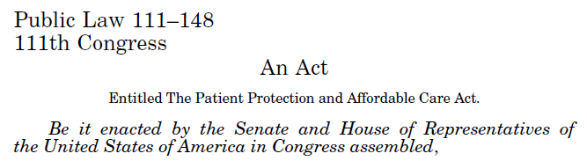
Role of the MC
Vision
PCORI methodological knowledge and standards are widely adopted as best practices across the PCORI stakeholder community.
Mission
To become the “go to” PCOR scientific methodology resource and the "how to" group for PCORI—addressing methodological areas of focus, advancing methodological science and, thereby, enabling PCORI to accomplish its agenda.
Scientific Advisor to the Board
The Methodology Committee also serves as scientific advisor to the Board regarding research, dissemination, infrastructure and capacity building as well as patient and stakeholder engagement

Slide 12
1st Methodology Report Objectives
guidance about the appropriate use of methods in PCOR
establishing priorities to address gaps in research methods or their application
recommending actions to support standards
mapping research methods to specific research questions (Translation [decision] Table)

Slide 13
Methodology Report
The mandate for PCORI’s Methodology Committee is to define methodological standards and a translation (decision) table to guide health care stakeholders towards the best methods for patient-centered outcomes research (PCOR).
Rigorous methods are essential to building trust in research findings.
Prevailing research practices do not generate research optimized to guide decision making.
Once Report is revised and accepted by the PCORI Board of Governors, future PCORI funding applicants will be expected to reference the Standards in their applications and use the Standards in their PCORI funded research.
13

Slide 14
Methodology Report – What is a Standard?
Building on the work of the Institute of Medicine,* the Methodology Committee defined a standard as…
A process, action, or procedure for performing PCOR that is deemed essential to producing scientifically valid, transparent, and reproducible results; a standard may be supported by scientific evidence, reasonable expectation that the standard helps achieve the anticipated level of quality in PCOR, or by broad acceptance of the practice in PCOR
The recommendation is actionable, feasible, and implementable
Proposed standards are intended for use by the PCORI Board, in PCORI policies and procedures, and by PCORI researchers
*Reference: National Research Council. Find What Works in Health Care: Standards for Systematic Reviews. Washington, DC: The National Academies Press; 2011.
14

Slide 15
Methodology Report – What Questions Should our Standards Address?
The MC sought to address selected topics in 4 broad phases of research activities in the first Methodology Report:
What should we study?
What study designs should we use?
How do we carry out and govern the study?
How do we enable people to apply the study results?
15

Slide 16
Methodology Report Development
1
Working groups identified and prioritized major research methods questions to be addressed
Methods Selection
2
Researchers contracted to address selected topics by identifying existing standards, guidance, etc. and developing reports and drafts of proposed standards
MC solicited for external feedback on the translation table (RFI)
Workshops held to discuss contractor findings, with invited experts in attendance
Information Gathering
Committee Expertise
3
MC conducted in-depth internal review of materials developed by contractors, and support staff
MC independently submitted preliminary votes on proposed standards
MC deliberated to reach consensus on standards to be endorsed in the report
Internal Review
4
MC refined standards and developed accompanying narrative
Report Generation
16

Slide 17
1st Methodology Report – Information Gathering
Research Teams
~100 individuals comprised of 17 groups from across the country were contracted to conduct research from Nov. 2011 to May 2012
Workshop External Invitees
15 experts attended two workshops in March 2012 to provide additional perspectives
Translation Table RFI Respondents
24 submissions were received in response to a Request for Information (RFI) to provide input on the translation table framework

Slide 18
1st Methodology Report – Information Gathering
Electronic Data Systems Interviewees
57 stakeholders were interviewed to understand CER-use in electronic health records and informatics
Independent Consultants
8 individuals were contracted to serve as report editors and interim researchers
Reproducible Research Results
An interim PCORI researcher, in partnership with Steven Goodman (Chair, Research Methods Work Group) and with input from the MC, conducted a literature review on reproducible and transparent research; findings directly informed PCORI’s reproducible and data sharing policies

Slide 19
1st Methodology Report – Information Gathering
17 reports* addressing 15 topics, from MC-led contracted research, informed 1st Report
Topics
Design, Conduct, and Evaluation of Adaptive Randomized Clinical Trials
Conduct of Registry Studies
Design of Patient-Reported Outcomes Measures (PROMS)
Use of Collaborative or Distributed Data Networks
Prevention and Handling of Missing Data
Design, Conduct and Evaluation of Diagnostic Testing
Causal Inference Methods in Analyses of Data from Observational and Experimental Studies
Addressing Heterogeneity of Treatment Effects: Observational and Experimental PCOR
*Reports are available on PCORI’s website (www.pcori.org)

Slide 20
1st Methodology Report – Information Gathering
Contracted Research Reports (Cont’d)
Topics
Involving Patients in Topic Generation
Value-of-Information in Research Prioritization
Peer Review as a Method for Research Prioritization
Examination of Research Gaps in Systematic Reviews for Research Prioritization
Integrating Patients' Voices in Study Design Elements with a Focus on Hard-to-Reach Populations
Eliciting Patient Perspective
PCORI Expert Interviews
*Reports are available on PCORI’s website (www.pcori.org)

Slide 21
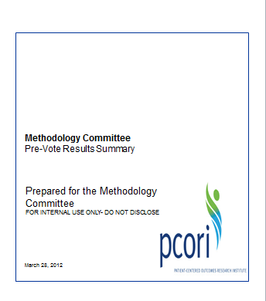
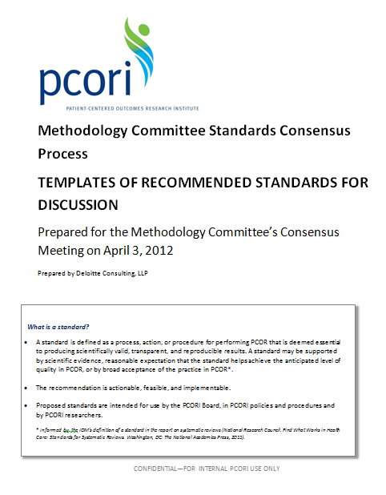
1st Methodology Report – Internal Review
Process:
Recommendations Proposed by Work Groups
Reviewed and refined contractors’ deliverables and findings
Reached consensus on recommendations to propose for inclusion in the 1st report
Full Committee
Pre-Vote
Independently reviewed and voted on 82 proposed recommendations
51 recommendations received at least two-thirds approval, thus qualifying for inclusion in the report
Committee Consensus Meeting
Discussed 31 recommendations where discrepancies arose during the pre-vote
Submitted final votes and considered each standard as a minimum requirement for PCORI
Chairs Review

Slide 22
Methodology Report – Internal Review
The MC deliberated and agreed upon standards based on the following:
Patient-Centeredness
Respect for and responsiveness to individual patient preferences, needs, and values
Scientific Rigor
Objectivity, minimizing bias, improving reproducibility, complete reporting
Transparency
Explicit methods, consistent application, public review
Empirical/ Theoretical Basis
Information upon which a proposed standard is based
Other Considerations
Practicality, feasibility, barriers to implementation, and cost
22

Slide 23
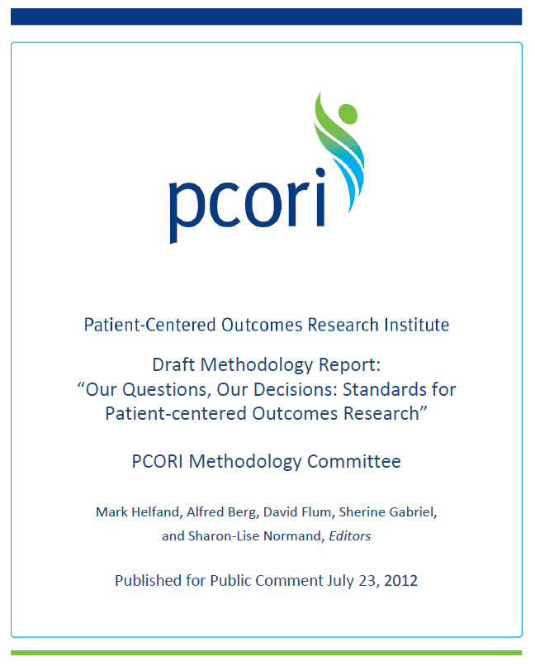
Methodology Report
Submitted to the PCORI Board of Governors on May 10, 2012
Accepted by the PCORI Board of Governors on May 21, 2012
A public comment period on the draft report: Through September 14 2012
Revised Report goes to the Board of Governors November 2012
23

Slide 24
Methodology Report – Research Domains
Patient-
Centeredness
Patient
Engagement
Research
Prioritization
Causal
Inference
General and
Crosscutting
Heterogeneity
of Treatment
Effects
Missing
Data
Data
Networks
Adaptive
Trials
Data
Registries
Diagnostic
Testing
24

Slide 25
Commitment to Patient Engagement
Bringing patients’ and caregivers’ voices to research is one of PCORI’s core values.
The development and widespread adoption of standards for patient-centeredness and engagement in research is critical for helping patients and caregivers make more informed health decisions.
The draft Report’s “patient-centeredness” standards were informed, in part, by patients and caregiver interviews and focus groups throughout the country.
PCORI looks forward to continually tapping into the energy and wisdom of the patient, caregiver and other stakeholder communities to create a new model for research.
25

Slide 26
Patient-Centeredness and the draft Methodology Report
The standards include specific calls for patient involvement in all phases of patient-centered outcomes research (PCOR) including:
Formulating research questions
Defining essential characteristics of study participants, comparators, and outcomes
Monitoring study conduct and progress
Disseminating results
The proposed standards also highlight the importance of patient participation in the process of prioritizing which research proposals are funded.
26

Slide 27
What Makes a Study Patient-Centered?
Patient-centered outcomes research starts from the perspective of individuals facing health decisions.
Every phase of patient-centered outcomes research should be directed towards informing health decisions that affect outcomes meaningful to patients.
Patient-centered outcomes research helps people make informed health care decisions.
27

Slide 28
Patient Engagement
Source: ¹Curtis P, Slaughter-Mason S, Thielke A, Gordon C, Pettinari C, Ryan K, Church B, King V (2012). PCORI Expert Interviews Project: Final report. Portland, OR: Center for Evidence-based Policy, Oregon Health & Science University
28

Slide 29
Standards for Patient-Centeredness and Engagement
3.1.2 Identify Specific Populations and Health Decision(s) Affected by the Research
3.1.5 Measure Outcomes that People in the Population of Interest Notice and Care About
4.1.1 Engage Patient Informants, Persons Representative of the Population of Interest, in All Phases of Patient-centered Outcomes Research (PCOR)
4.1.2 Identify, Select, Recruit, and Retain Study Participants Representative of the Spectrum of the Population of Interest Facing the Health Decision of Interest and Ensure that Data Are Collected Thoroughly and Systematically from All Study Participants
4.1.3 Use Patient-Reported Outcomes When Patients or People at Risk of a Condition Are the Best Source of Information
4.1.4 Develop and Implement a Dissemination Assessment to Achieve Broad Awareness of Study Results
29

Slide 30
Dissemination and implementation of PCORI methods standards and guidance
MC ultimate goal:
Improve the value of PCOR and its contributions to better health decisions and outcomes
To attain the goal:
Improve research practice by achieving high levels of adherence to PCORI MC standards and “best practice” recommendations

Slide 31
Changing research practices
“Research practices” include a broad and varied set of decisions and activities conducted by numerous stakeholders (funders, reviewers, researchers, etc.)
Changing these practices is challenging
Researchers value independence, autonomy and professional judgment
Researcher actions are guided by knowledge, experience and judgment
Analogue: the challenge of improving research practices is comparable to the challenge of improving clinical practices (e.g., through evidence-based clinical practice guidelines)

Slide 32
Guidance from implementation science
Guidance from implementation science: approaching an implementation problem
1. Identify high priority quality/outcome gaps: deficiencies in research practices
2. Identify or develop evidence-based guidelines/best practice recommendations: MC report
3a. Document current practices and their determinants: MC D&I Plan conceptual model of the research process
3b. Document and prioritize quality/implementation gaps (adherence gaps): MC rating/prioritization process
3c. Diagnose implementation gaps: MC judgment and/or empirical research
3d. Identify barriers/facilitators to practice change: MC judgment and empirical research
4. Develop a multi-faceted/multi-component implementation strategy (“campaign”): see next slide
5. Deploy, evaluate and refine the implementation campaign (via phased activities) to maximize effectiveness
Guidance from implementation science: designing and implementation campaign
Professional practices are influenced by multiple factors operating at multiple levels
Implementation gaps must be thoroughly diagnosed (to identify “root causes”) to guide practice change strategies; “empirical treatment” is ineffective
Implementation campaigns must include multiple, coordinated components targeting the full spectrum of implementation gap determinants
A comprehensive causal model (“logic model”) helps identify determinants of current practices and practice gaps, and thus to guide selection of implementation strategies
“No magic bullets”: examples of dramatic change in research practices (e.g., trial registration) are rare and exceptional
Identify high priority gaps: deficiencies in research practices
Identify or develop evidence-based guidelines/best practice recommendations: MC report
Document determinants of current practice: MC D&I Plan
Prioritize implementation gaps: MC judgment and empirical research; prioritization
Identify barriers/facilitators to practice change: MC judgment and empirical research
Develop the implementation strategy
Deploy, evaluate and refine

Slide 33
Designing an implementation campaign: core principles
Professional practices are influenced by multiple factors operating at multiple levels
Implementation gaps must be thoroughly diagnosed (to identify “root causes”) to guide practice change strategies; “empirical treatment” is ineffective
Implementation campaigns must include multiple, coordinated components targeting the full spectrum of implementation gap determinants
A comprehensive causal model (“logic model”) helps identify determinants of current practices and practice gaps, and thus to guide selection of implementation strategies
There are “no magic bullets”: examples of dramatic change in research practices (e.g., trial registration) are rare and exceptional

Slide 34
Conceptual model of the research process
Research question identification and prioritization (funding agencies)
Study design and methods selection (researcher judgment guided by training, professional norms, published standards)
Peer review, IRB review (reviewer judgment guided by training, professional norms, published standards)
Study governance and conduct (researcher judgment, possibly guided by reporting requirements, IRB review, DSMB review)
Documentation and reporting (researcher judgment guided by reporting guidelines, journal requirements, peer review)

Slide 35
Designing a MC report dissemination/ implementation campaign
User engagement and buy-in: participation in development, review, revision, endorsement
Development of “decision support tools”
Dissemination plan: “early and often,” employing opinion leaders and involving multiple channels and messages
target audiences, content (model newsletter articles, email announcements, presentations), opportunities and channels
Partnerships with research funding agencies to incorporate standards in research funding announcements, grant requirements, peer review processes
Partnerships with training programs to incorporate standards in educational activities
Partnerships with professional associations to incorporate standards in continuing education activities and to achieve endorsement of standards

Slide 36
We look forward to your comments on the Draft Methodology Report
Visit www.pcori.org
Subscribe to PCORI updates at pcori.org/subscribe
Follow @PCORI on Twitter
Watch our YouTube channel PCORINews
36

Slide 37
Supplementary Slides
37

Slide 38
Research Prioritization
Need to select from among all possible research topics
Methodology Committee Process
Consider Prioritization Factors
Develop Framework for Establishing Priorities
Created Standards for selected components of Framework
Standards must align with overall PCORI approach
Promote patient-centeredness and engagement
38

Slide 39
Prioritization Factors
Disease or condition incidence, prevalence and burden
Patient needs, outcomes and preferences
Gaps in evidence
Relevance to informed health decisions
Potential for improvement based on new evidence
Efficient use of PCORI research resources
Priorities developed by other organizations
39

Slide 40
Methods to Assist in Prioritization
Topic Generation
Identify questions that could be studied
Gap Analysis in Systematic Review
Reviewing what has already been studied and figuring out what questions research has not answered yet
Value of Information Analysis
A conceptually-driven framework for estimating the impact that new information from research could have
Peer/Stakeholder Review
Involving patients and other decision-makers in deciding what to study
40

Slide 41
Framework for Prioritization
Topic Generation
Gap Analysis in Systematic Review
Value of Information Analysis
Peer/Stakeholder Review
Value of Information
41

Slide 42
Standards for Research Prioritization
5.1.1 Use Systematic Reviews to Identify Gaps in Evidence
5.1.2 Protect Independence in Peer Review of Research Funding Proposals
5.1.3 Ensure Adequate Representation of Minorities and Disadvantaged Segments of the Population in Peer Review of Research Funding Proposals
42

Slide 43
General Research Standards
3.1.3 Identify and Assess Participant Subgroups
3.1.4 Select Appropriate Interventions and Comparators
7.1.1 Assess Data Source Adequacy
7.1.2 A Priori, Specify Plans for Data Analysis that Correspond to Major Aims
7.1.3 Document Validated Scales and Tests
7.1.4 Use Sensitivity Analyses to Determine the Impact of Key Assumptions
7.1.5 Provide Sufficient Information in Reports to Allow for Assessments of
the Study’s Internal and External Validity
43

Slide 44
Causal Inference Standards
7.2.1 Define Analysis Population Using Information Available at Study Entry
7.2.2 Describe Population that Gave Rise to the Effect Estimate(s)
7.2.3 Precisely Define the Timing of the Outcome Assessment Relative to the Initiation and Duration of Intervention
7.2.4 Measure Confounders before Start of Exposure
7.2.5 Assess Propensity Score Balance
7.2.6 Assess Instrumental Variable Assumptions
44

Slide 45
Heterogeneity of Treatment Effects
People react differently to treatment
Problems with summary / average effects
Averages combining diverse types of people are not useful for decisions
Do not answer “what will happen to people like me”
Challenges in dividing patients in ‘right’ groups
45

Slide 46
Heterogeneity (HTE) Standards
7.3.1 State the Goals of HTE Analyses
7.3.2 For Confirmatory and Descriptive HTE Analyses, Pre-specify Subgroups and Outcomes; for Confirmatory HTE Analyses, Pre-specify Hypotheses for Each Subgroup Effect
7.3.3 For Confirmatory HTE Analyses, Report a priori Statistical Power
7.3.4 For Any HTE Analysis, Perform an Interaction Test and Report Sufficient Information on Treatment Effect Estimates
7.3.5 For Exploratory HTE Analyses, Discuss Findings in the Context of Study Design and Prior Evidence
7.3.6 For Any HTE Analysis, Report All Pre-specified Analyses and, at Minimum, the Number of Post-hoc Analyses, Including Number of Subgroups and Outcomes Analyzed
46

Slide 47
Missing Data Standards
7.4.1 Describe in Protocol Methods to Prevent and Monitor Missing Data
7.4.2 Describe Statistical Methods to Handle Missing Data in Protocol
7.4.3 Use Validated Methods to Deal with Missing Data that Properly Account for Statistical Uncertainty Due to Missingness, Such as Multiple Imputation. All Forms of Single Imputation Are Discouraged
7.4.4 Record and Report All Reasons for Dropout and Missing Data, and Account for All Patients in Reports
7.4.5 Examine Sensitivity of Inferences to Missing Data Methods and Assumptions, and Incorporate into Interpretation.
47

Slide 48
Data Networks
Explosion of new data
Electronic Medical Records (EMRs)
Linking data sets
New data collection technology
Need to assure
Patient Privacy
Data quality
Consistency
48

Slide 49
Data Network Standards
7.5.1 Data Integration Strategy
7.5.2 Risk Assessment Strategy
7.5.3 Identity Management and Authentication of Individual Researchers
7.5.4 Intellectual Property Policies
7.5.5 Standardized Terminology Encoding of Data Content
7.5.6 Metadata Annotation of Data Content
7.5.7 Common Data Model
49

Slide 50
Adaptive Trials
Flexible not fixed
Adjust based on results that are monitored during study period
Advantages
More relevant
Faster results
Less expensive (sometimes)
Challenges
Complex to conduct
Need to be careful not to introduce bias into the study
50

Slide 51
Adaptive Trial Standards
8.1.1 Specify Planned Adaptations and Primary Analysis
8.1.2 Evaluate Statistical Properties of Adaptive Design
8.1.3 Specify Structure and Analysis Plan for Bayesian Adaptive
Randomized Clinical Trial Designs
8.1.4 Ensure Clinical Trial Infrastructure Is Adequate to Support
Planned Adaptation(s)
8.1.5 Use the CONSORT Statement, with Modifications, to Report
Adaptive Randomized Clinical Trials
51

Slide 52
Registries
Database
Information generated during normal care
Focused on a disease or treatment
Data from multiple sources
Challenges
Privacy
Data Quality and Consistency
Sorting out cause and effect
52

Slide 53
Registry Standards
8.2.1 Describe Data Linkage Plans, if Applicable
8.2.2 Plan Follow-up Based on the Registry Objective(s)
8.2.3 Describe Data Safety and Security
8.2.4 Take Appropriate Steps to Ensure Data Quality
8.2.5 Document and Explain Any Modifications to the Protocol
8.2.6 Collect Data Consistently
8.2.7 Enroll and Follow Patients Systematically
8.2.8 Monitor and Take Actions to Keep Loss to Follow-up to an Acceptable Minimum
8.2.9 Use Appropriate Statistical Techniques to Address Confounding
53

Slide 54
Diagnostic Tests Standards
8.3.1 Specify Clinical Context and Key Elements of Diagnostic Test
Study Design
8.3.2 Study Design Should Be Informed by Investigations of the
Clinical Context of Testing
8.3.3 Assess the Effect of Factors Known to Affect Diagnostic
Performance and Outcomes
8.3.4 Structured Reporting of Diagnostic Comparative Effectiveness
Study Results
8.3.5 Give Preference to Randomized Designs of Studies of Test
Outcomes
54

