Slide 1
What Does PCORI Want?
An Open Discussion of PCORI Reviews,
Reviewers and Successes
Lenore Arab, PhD, MSc

Slide 2
RRT Supports 5 Major Grant Preparation Milestones
RRT invites and hosts structured brainstorming sessions involving potential investigators from all CTSI institutions.
Search for new FoAs multiple times a week and upload onto our website
Send out bi-monthly digests to mailing list
Brainstorming & Viability Assessment
Writing & Budget Preparation
Awareness of
Potential Funding
RRT grant proposal management software provides:
Tailored Time and People management
Automated task assignments and preset deadlines for 85 tasks
Automated Email Notifications
Real-time project access
Shared document functionality
Mock Review
Revision & Resubmission
RRT suggests new opportunities for unfunded proposals
RRT provides support in facilitating internal and external review processes

Slide 3
The Rapid Response Team
Dr. Lenore Arab, Director
Robin Faria, Director of Operations
Two Positions Currently Available!
Do you know someone who is passionate about advancing science and bringing groups together, can write well and has a scientific background with experience in grant applications?
The RRT is hiring NOW!
Position is held jointly under the Associate Dean of Research and CTSI.
For more information, email RRT at RRT@mednet.ucla.edu.

Slide 4
PCORI Mission Statement
The Patient-Centered Outcomes Research Institute (PCORI) helps people make informed health care decisions,
and improves health care delivery and outcomes,
by producing and promoting high integrity, evidence-based information
that comes from research guided by patients, caregivers and the broader health care community.

Slide 5
PCORI Research answers patient-centered questions:
“Given my personal characteristics, conditions and preferences, what should I expect will happen to me?”
“What are my options and what are the potential benefits and harms of those options?”
“What can I do to improve the outcomes that are most important to me?”
“How can clinicians and the care delivery systems they work in help me make the best decisions about my health and healthcare?”

Slide 6
New PCORI Approved Review Criteria
Impact of the Condition on the Health of Individuals and Populations
Innovation and Potential for Improvement
Impact on Health Care Performance
Patient-Centeredness
Rigorous Research Methods
Inclusiveness of Different Populations
Research Team and Environment
Efficient Use of Research Resources

Slide 7
Criterion 1 – Impact of the Condition on the Health of Individuals and Populations
How strongly does the application make the case that the target condition creates a major burden on the US population, including:
Frequency of Occurrence
Mortality
Suffering from symptoms
Complications or other consequences
Loss of productivity
Costs to the US population (healthcare services utilization), and to individual patients (out-of-pocket and intangible costs)

Slide 8
Criterion 1 – Impact of the Condition on the Health of Individuals and Populations (2)
Convincing argument that the new information provided by the study will lead to a decrease in the burden attributable to the target condition?
Emphasis on chronic conditions, patients with two or more chronic conditions
Prevention and treatment of common acute events that may have long-term consequences
Interest in Rare diseases

Slide 9
Criterion 2 – Innovation/Potential for Improvement
How will the research influence current practice and lead to meaningful improvement in patient health, well-being, or quality of care?
Does the research involve a novel intervention or employ an innovative approach in terms of analytics, study population, or research team that makes it more likely to change practice?
Does preliminary data suggest that the comparison could change current assumptions about effectiveness?

Slide 10
Criterion 2 – Innovation/Potential for Improvement
Does the research question address a critical hap in current knowledge? Has it been identified as important by patient, caregiver, or clinician groups? Have other agencies identified the topic as a priority?
How quickly could positive findings be disseminated to affect changes in current practice? How will the research findings support improved decision-making?

Slide 11
Criterion 5 – Dissemination and Implementation Assessment

Slide 12
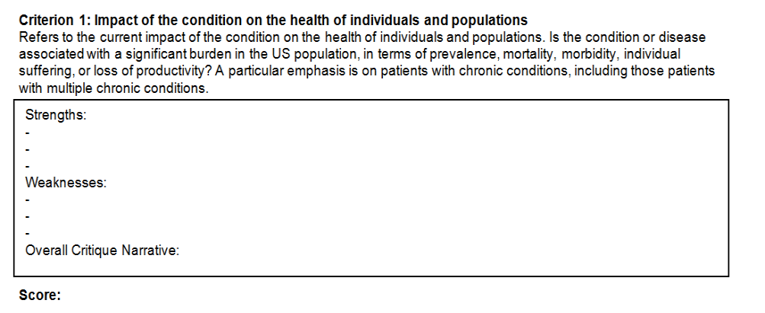

Slide 14
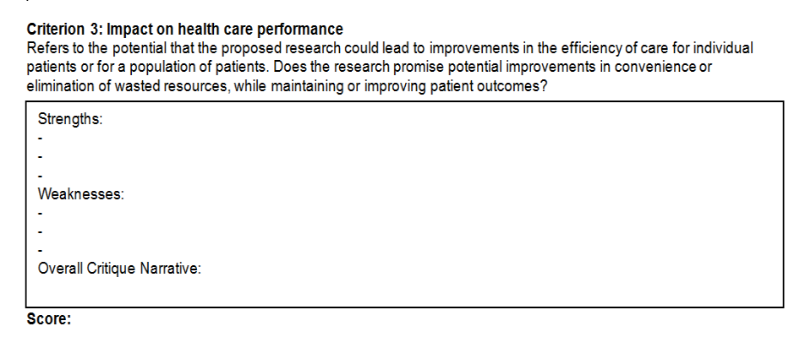

Slide 15
Criterion 4: Patient-Centeredness
Is the proposed research focused on questions and outcomes of specific interest to patients and their caregivers? Does the research address one or more of the key questions mentioned in PCORI’s definition of patient-centered outcomes research? Is the absence of any particularly important outcomes discussed?
Criterion 5: Rigorous research methods
Refers to the use of appropriate and rigorous research methods to generate patient-centered evidence, including appropriate choice of study design and of analytic methods. How likely is it that the proposed study population, study design, and available sample size will yield unbiased, generalizable information with sufficient precision to be useful and reliable for patients, their caregivers, and clinicians?
Criterion 6: Inclusiveness of different populations
Does the proposed study include a diverse population with respect to age, gender, race, ethnicity, geography, or clinical status? Alternatively, does it include a previously understudied population for whom effectiveness information is particularly needed? Does the study have other characteristics that will provide insight into a more personalized approach to decision making based on a patient’s unique biological, clinical, or sociodemographic characteristics.

Slide 16
Criterion 7: Research team and environment The research team must be appropriately trained and experienced to carry out the planned studies.
Does the study team have complementary and integrated research expertise in implementing the study?
Are relevant patients and other key users of the study information (eg, caregivers, clinicians, health system, community, or policy makers) appropriately included on the team?
Will the research environment contribute to the probability of success?
Are features of the research environment, such as health system or community involvement or collaborative arrangements, described?
Are institutional and community investment in the success of the research described?

Slide 17
Criterion 8: Efficient use of research resources
Does the budget appear to be reasonable in relation to the potential contribution of the research?
Does the justification address the efficiency with which PCORI resources would be used?
Are there opportunities to make the study more efficient?
Are there additional benefits to a PCORI investment in this study through the creation of common data or infrastructure that could support future research?

Slide 18
The only PCORI Funded study in CA the last round: PI Dr. Ken Wells
 | Primary | Secondary | Tertiary | Quaternary
Phase 2 Reviewer Summary: Overall Impact Score | 2 | 3 | 3 | 3
Phase 1 Reviewer Summary: Overall Application Score | 6 | 3 | 1
Impact of the Condition on the health of individuals and populations | 5 | 3 | 2
Innovation and potential for improvement through research | 5 | 3 | 2
Impact on health care performance | 6 | 3 | 2
Patient-Centeredness | 7 | 1 | 1
Rigorous research methods | 3 | 3 | 2
Inclusiveness of different populations | 3 | 1 | 1
Research team and environment | 3 | 1 | 1
Efficient use of research resources | 5 | 3 | 5
Overall application score and comment | 6 | 3 | 1

Slide 19
Phase 2 Average Score: 2.37 Summary Statement
Strong group of investigators
Six-month finding
Well-designed research plan
Empirically examine how community engagement impacts long-term disparities
Robust and patient-centered, with a diverse population

Slide 20
Impact Review Phase 2
Primary Comment
Strengths
High impact, high priority condition, poor overall medical and public health successes to date
Condition with large disparities, differences in patient preferences in therapies
Well-developed comparative effectiveness intervention
Good, experienced research and leadership team
Strong initial results
Weaknesses
Potential loss to follow-up
Changes in providers
Overall Narrative Critique
Randomized community trial of two alternative quality improvement strategies to improve care and outcomes in safety-net settings in Los Angeles.

Slide 21
Impact Review Phase 2
Secondary Comment
Potential to impact practice within the next 3-5 years
Patient-centeredness of the proposed research
Continued stakeholder engagement throughout data collection, analysis, report writing, and dissemination
Identifies and compares promising practices that address contextual factors
Relatively large portion of the requested budget that is going to the researcher elements of the project team versus the community members

Slide 22
Impact Review Phase 2
Tertiary Comment
Not clear whether this community engagement was ongoing in the development of this particular study, not just the planned interviews within it
Would be stronger if it showed how partner organizations played a role in the development
What role will patients play on the study team going forward?

Slide 23
Phase 1 Reviewer Summary: Impact on Individuals and Populations
Primary Comment
Weaknesses
Overall prevalence not addressed
Proposal would benefit from more information about the impact especially in the target population group

Slide 24
Phase 1 Reviewer Summary: Innovation
Primary Comment
Strengths
Research is innovative
Initial study shows impact on specific health outcomes
Few effective longitudinal studies exist

Slide 25
Phase 1 Reviewer Summary: Impact on Health Care Performance
Primary Comment
Overall Critique Narrative
Study does not appear to address how other factors outside the influence of the initial intervention may impact outcome changes three years post end of the intervention
If these changes occurred, it is not clear how such factors would be taken into account
What impact will the intervention have on how the community providers offered services and what impact that might have made on the outcomes?

Slide 26
Phase 1 Reviewer Summary: Patient-Centeredness
Secondary Comment
Strengths
Aligns ideally with PCORI’s definition of patient-centered outcomes research
Tertiary Comment
Overall Critique Narrative
Found this proposal to be the most rigorous, theory-driven, and authentic in its patient-centered orientation and patient engagement of the proposals reviewed.

Slide 27
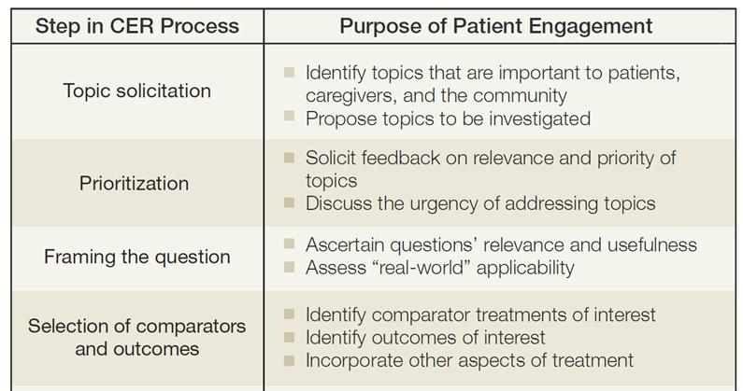
10 Components of Stakeholder Engagement

Slide 28
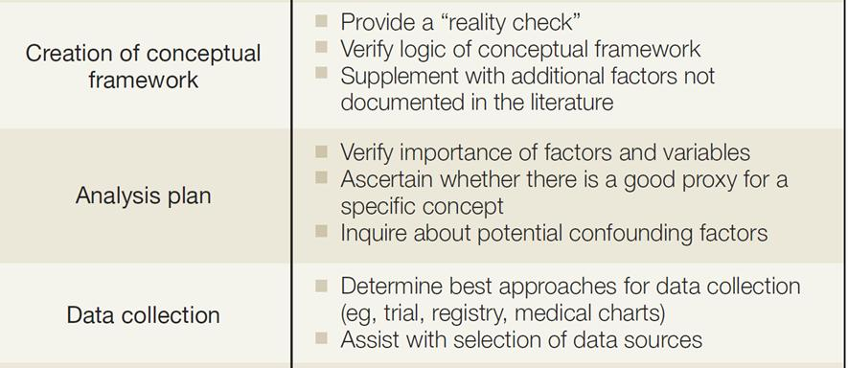
10 Components of Stakeholder Engagement

Slide 29
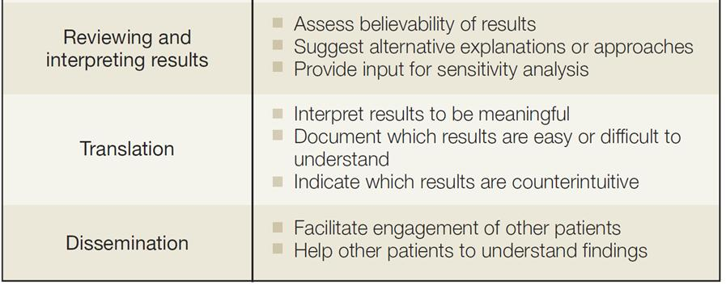
10 Components of Stakeholder Engagement

Slide 30
Phase 1 Reviewer Summary: Rigorous Research Methods
Tertiary Comment
Weaknesses
Significant selection biases in loss to follow up
Overall Critique Narrative
The proposal is outstanding and close to exceptional in its rigor and in the fit of the research design to the aims. The team is experienced in carrying out analyses
The mixed-methods approach is well suited to the qualitative aims of understanding client priorities and providers capacities on the one hand, and to the quantitative aim on the other

Slide 31
Phase 1 Reviewer Summary: Inclusiveness of Different Populations
Primary Comment
Overall Critique Narrative
This area represents another unique strength of the application
Addresses care needs of those representing a wide range of demographic characteristics
Allows for the understanding of how these characteristics might influence long-term outcomes

Slide 32
Phase 1 Reviewer Summary: Research Team and Environment
Primary Comment
Weaknesses
Not clear if patients are involved on the study team
Features of the research environment could have been described in more details
Overall Critique Narrative
Planned involvement of the community partners is weak and appears to be more of a token representation with a minimal role in the study.
It is not clear if the patients are involved in the study team and a more detailed description would have been beneficial

Slide 33
Phase 1 Reviewer Summary: Efficient Use of Resources
Primary Comment
Weaknesses
Compensation to participants seems minimal given overall size and scope
Unclear if the research team considered alternatives to compensation individuals in a more meaningful way or considered higher participant payment.
Secondary Comment
Strengths
Excellent discussion of shared resources
Weaknesses
Will this proposal create a common infrastructure or outcome measures that could have wider impact beyond the study parameters?

Slide 34
Five Potential Topics for Targeted PFAs
Treatment Options for Uterine Fibroids
Treatment Options for Severe Asthma in African-Americans and Hispanics/Latinos
Preventing Injuries from Falls in the Elderly
Treatment Options for Low Back Pain (new)
Obesity Treatment Options in Diverse Populations (new)

Slide 35
Proposed Timeline for Targeted PFAs
Proposed Timeline
PFAs Released | June 1, 2013
LOIs Due | July 1, 2013
Full Applications Due | August 1, 2013
Application Reviews Completed | October 15, 2013

Slide 36
Research Areas of Interest: Preventing Injuries from Falls in the Elderly
Compare different strategies for preventing falls, including exercise and balance training.
Compare promising strategies among older adults at varying degrees of risk
Compare strategies to overcome patient-, or system-level barriers (eg language, culture, transportation, homelessness, unemployment, lack of family/caregiver support) and thereby reduce risk of falls and resulting injuries. Strategies may focus on different segments of at-risk populations, such as hospital inpatients, residents of nursing homes, and older people with osteopenia and osteoperosis.

Slide 37
Research Areas of Interest: Obesity Treatment Options in Diverse Populations
Compare culturally tailored, community-based interventions to improve patient-centered outcomes in obesity treatment for diverse populations.
Identify and compare promising practices that address contextual factors such as socioeconomic, demographic, or community factors and their impact on obesity outcomes.
Compare benefits and risks of surgical, pharmacological, and other medical treatment options.

Slide 38
Research Areas of Interest: Obesity Treatment Options in Diverse Populations, Continued
Compare strategies to overcome patient-, provider-, or system-level barriers that may adversely affect diverse populations with obesity and are relevant to their choices for preventive, diagnostic, and treatment strategies.
Different segments of populations with different obesity parameters or patients with additional risk factors.

Slide 39
Research Areas of Interest: Treatment Options for Severe Asthma in African Americans and Hispanics/Latinos
Compare interventions to improve patient-centered outcomes in patients with severe asthma including health, health care, and patient-reported outcomes.
Compare benefits and risks of asthma treatments, including long-acting beta agonists and low- or medium-dose inhaled corticosteroids.
Compare strategies to overcome patient-, provider- or system-level barriers that may adversely affect minority patients and are relevant to their choices for preventive diagnostic, and treatment strategies
Focus on different segments of populations, severity levels of asthma, and involve patients with multiple risk factors.

Slide 40
Research Areas of Interest: Treatment Options for Uterine Fibroids
Identify and compare promising strategies to identify and choose treatment options for fibroid management, including those tailored for different subpopulations
Focus on different segments of reproductive-age women who are affected by differing symptom severity, reproductive preferences, or involve patients with additional risk factors.

Slide 41
Research Areas of Interest: Treatment Options for Uterine Fibroids, Continued
Compare interventions to evaluate the relative effectiveness of the available procedural or nonprocedural treatments for uterine fibroids.
Address relative effectiveness of procedural treatments on durability of symptom relief and patient reported outcomes
Staging of treatments, including the pharmacotherapeutic options as initial therapy on durability of symptom relief and patient reported outcomes

Slide 42
Research Areas of Interest: Treatment Options for Back Pain
Compare multidisciplinary treatment approaches with single treatment approaches for pain reduction and other patient-reported outcomes in people with chronic back pain.
Address the effectiveness of various treatments or combinations of treatments for reducing chronic pain.
Identify the most effective treatment strategies for different subpopulations
Identify the most effective treatment strategies for various causes of back pain
Compare treatments in order to evaluate the relative effectiveness of the available treatments for pain reduction and other patient-reported outcomes

Slide 43
Increase in PFA Commitments for 2013
$355M will be committed to projects in 2013.

Slide 44
Special Thanks to Dr. Kenneth Wells
Thank You!
Thank You!
Contact us at: RRT@mednet.ucla.edu or (310) 267-4258

