Slide 1
Value of Information Analysis
Roger J. Lewis, MD, PhD
Department of Emergency Medicine
Harbor-UCLA Medical Center
Los Angeles Biomedical Research Institute
David Geffen School of Medicine at UCLA
Berry Consultants, LLC
Email: roger@emedharbor.edu

Slide 2
Outline
Introductory comments: what are we trying to achieve or understand?
Quantifying and assigning value to information
Qualitative introduction to Bayesian decision theory
Review of PCORI background report on value of information analysis
Discussion

Slide 3
Overall Goal or Key Question
What is the expected value of gathering additional information about the effectiveness of a new treatment (B) relative to a standard treatment (A)?
If you can quantify that expected value, then you can decide whether it is worth it to run (or fund) a new clinical trial comparing treatments A and B
If one could predict exactly what data one might obtain, then we could define the value of that information

Slide 4
Components of the Problem
Why is information on treatment efficacy valuable?
Better treatment decisions
Better outcomes, on average, most of the time
How do we quantify information?
Reduction in uncertainty
Best represented in a Bayesian framework
How do we quantify value of better outcomes?
Willingness to pay (WTP)

Slide 5
Value of a Clinical Trial
Consider the value of a clinical trial comparing the effectiveness of treatment B to A
Current
Information
Better, Partial
Information
New Trial
(Bayes Theorem)
δ_{Current}
δ_{New}

Slide 6
Value of a Perfect Clinical Trial
Consider the value of a perfect clinical trial comparing the effectiveness of B and A
Current
Information
Perfect
Information
Magic Trial
δ_{Current}
δ_{New}

Slide 7
Value of Perfect Information
Treatment B is certainly superior and treatment difference is perfectly defined
Value of choosing treatment B over treatment A is precisely known
δ
Expected value: weighted average = same value
Medium
positive

Slide 8
Expected Value of Outcomes
Treatment A
Treatment B
XX%
XX%
XX%
XX%
Complications
No Complications
Complications
No Complications
XX%
XX%
XX%
XX%
XX%
XX%
XX%
XX%
Survives after
Complication
Dies
Survives
Dies
Survives after
Complication
Dies
Survives
Dies
WTP ($)
WTP ($)
Value_{SC}
0
Value_{S}
0
Value_{SC}
0
Value_{S}
0
Weighted Average = Value A
Weighted Average = Value B

Slide 9
Incorporating Uncertainty in δ
Value of choosing treatment B over treatment A = weighted average (over uncertainty in δ) of difference in value of outcomes obtained with the two treatments
Larger positive δ results in larger, positive value due to a higher probability of survival
Negative δ would result in a negative value due to a higher probability of survival with treatment A than B

Slide 10
Value of Current Information
A range of relative effectiveness is consistent with current knowledge
Treatment B would be chosen
Value of choosing treatment B over treatment A:
δ
Large, positive
Expected value: weighted average of possibilities
Small, positive
Small, negative

Slide 11
Value of Better Information
A smaller range of relative effectiveness is consistent with current knowledge
Treatment B would be chosen
Value of choosing treatment B over treatment A:
Large, positive
Expected value: weighted average of possibilities
Small, positive

Slide 12
Why Information has Value
Better Information
About Efficacy
Less Uncertainty About δ
Selection of Preferred Treatment
More Likely to be Correct
Patient Outcomes More
Likely to be Good
Expected Utility of
Outcomes Is Higher
Good Outcomes Have
Higher Utility

Slide 13
Elements of Decision Theory
Prior information on state of nature (δ)
New data (sometimes)
Set of possible decisions or actions that can be taken (A∈A), perhaps including the option of collecting additional data
Utility function U(A, δ)

Slide 14
Concept of Utility Function
Utility function, U(A, δ), represents the value of taking a specific action A if the true state of nature is δ
U(Rx = A, δ)
U(Rx = B, δ)
δ

Slide 15
Basic Decision Principle
Choose the action A (A∈A) that maximizes the expected utility, given the current state of knowledge (must average over all the uncertainty, e.g., in δ or results of future trial)
Example:
Choice 1: Make Rx decisions based on current information (Utility ~ value of outcomes – cost of Rx)
Choice 2: Perform clinical trial and make Rx decisions based on future (unknown) information (Utility ~ value of outcomes – cost of Rx – cost of trial

Slide 17
Focus of PCORI Report
Ideal is to use value of information (VOI) analysis to allow a rational prioritization of future research activities
Reports were prepared under contract to PECORI; not official PCORI positions
Also addresses history of and barriers to use of VOI
Vast majority of use and experience in the UK

Slide 18
Focus of this Presentation
Report is organized in six sections
Brief description of VOI
Existing literature on VOI and research prioritization
Challenges to use of VOI for research prioritization
Unique challenges for PCORI
Suggestions for use of VOI by PCORI
My focus is on the underlying logic of VOI so we can discuss issues raised in the report

Slide 19
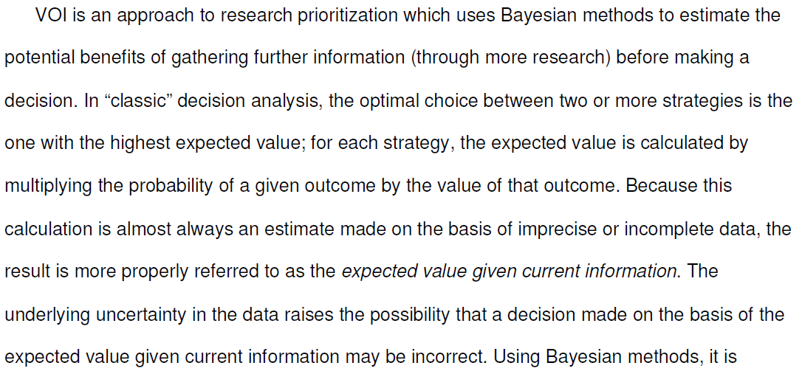
II. Description of VOI

Slide 20
II. Description of VOI
considering
Current
Perfect
Magic
δ
δ
Δ Value = EVPI

Slide 21
II. Description of VOI: Example
Two treatments (A vs B) for a potentially fatal disease
Treatments have the same cost but differ in effectiveness and complication rates
Complications have treatment costs
Value is measured in unadjusted life expectancy

Slide 22
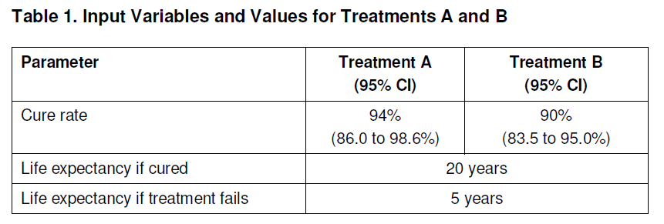
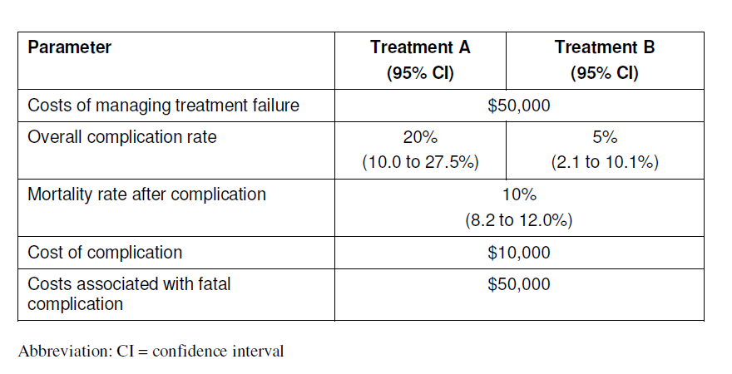

Slide 23
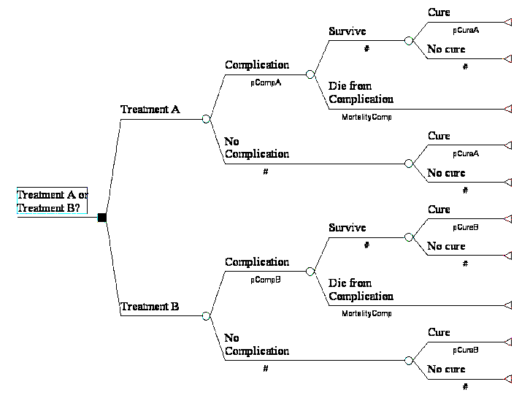
Average Life Expectancy
Average Life Expectancy

Slide 24
II. Description of VOI: Example
$215/0.32 years = $672/year but report says $692…

Slide 25
II. Description of VOI: Example
Net monetary benefit (NMB) is the value of the improvement in outcome, less the increased cost
(WTP × ΔQALY) – Net Costs
Value Costs

Slide 26
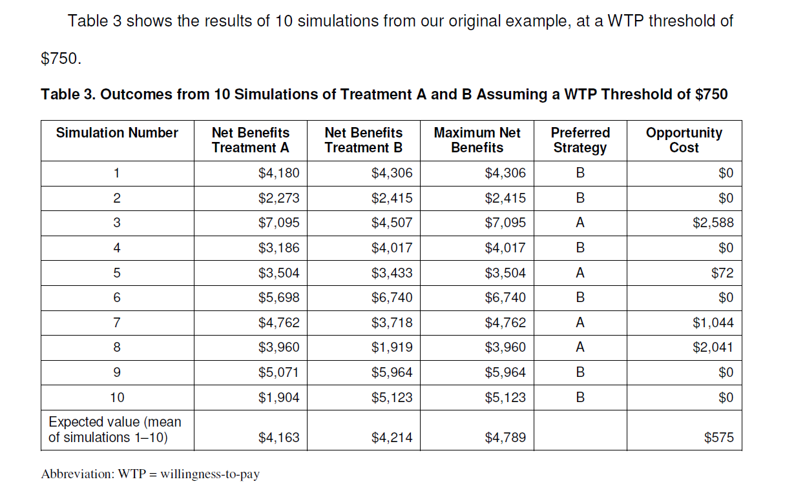
What About Uncertainty?
Based on 10 difference assumed “truths” for all unknown parameters, drawn randomly according to our current, imperfect knowledge

Slide 27
Further Concepts

Slide 28
III. Current State of VOI
Literature search to identify VOI papers addressing prioritization of research and includes specific recommendations for research priorities
Search for citations of identified VOI papers to define impact of VOI analyses

Slide 29
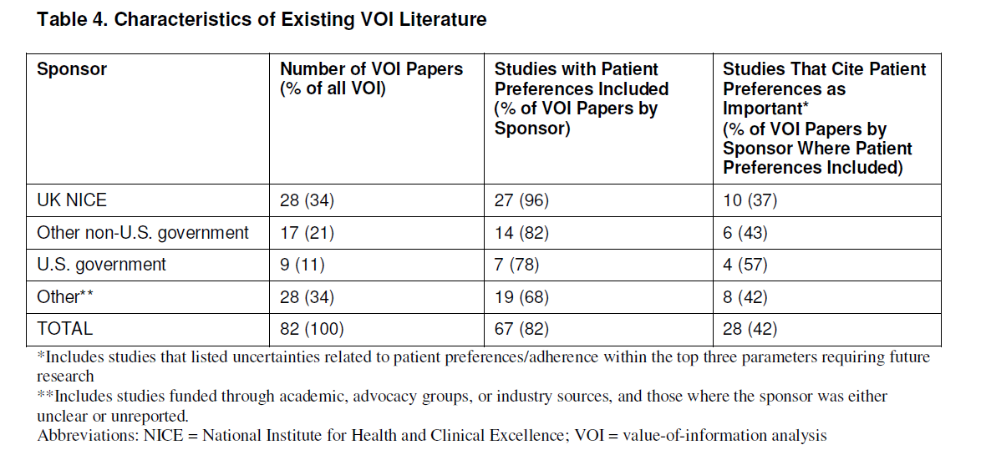
III. Current State of VOI

Slide 30
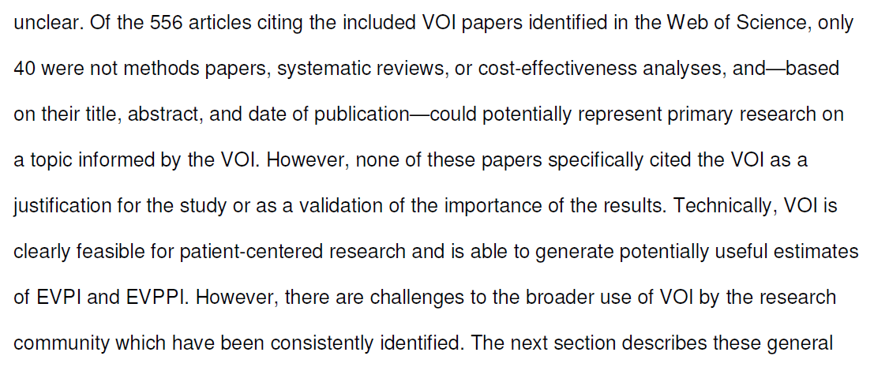
III. Current State of VOI

Slide 31
IV. Challenges to the Use of VOI
Required resources
Personnel with expertise and experience
Time (systematic review, model building, programming, calibration, and validation)
Computing resources
Concept of a “minimal modeling” approach as a partial solution

Slide 32
IV. Challenges to the Use of VOI
Scope of VOI
Prioritizing research across disease areas (deemed “impractical for the foreseeable future”)
Prioritizing research within a condition (e.g., screening vs. treatments for ovarian cancer)
Determining whether to pursue specific research (e.g., do we need to gather more information prior to recommending a treatment?)
Prioritizing research regarding common patient experiences across multiple conditions

Slide 33
IV. Challenges to the Use of VOI
Stakeholder Engagement: themes
Lack of familiarity with the methodology, especially in the US, and need for training
Timing of VOI—should VOI methodology be taught prior to a research prioritization activity or integrated into the activity itself?
VOI could be used prior to a RFA or after an initial review of applications

Slide 34
IV. Challenges to the Use of VOI
Heterogeneity in patient populations
Differential burden of disease or responses to treatment
Differences in patient preferences for outcomes
Differences in patient preferences for other attributes of care
Issue of equity: “…if population-level EVPIs are used to prioritize research…rare conditions would inevitably rank lower…”

Slide 35
IV. Challenges to the Use of VOI
Translation of research into improved clinical care is a key assumption of questionable truth

Slide 36
V. Specific Challenges for PCORI
One key challenge, specific to the legislation on which PCORI is based, forms the focus for this section

Slide 37
VI. Recommendations
Discussions/Conference with Other Policymakers
PCORI should engage with NICE and also NIH institutes and NCI
Need better evidence that VOI analyses will lead to more efficient use of research resources
PCORI needs to decide whether to invest in and use VOI analyses and, if so, develop a detailed strategy for its implementation

Slide 38
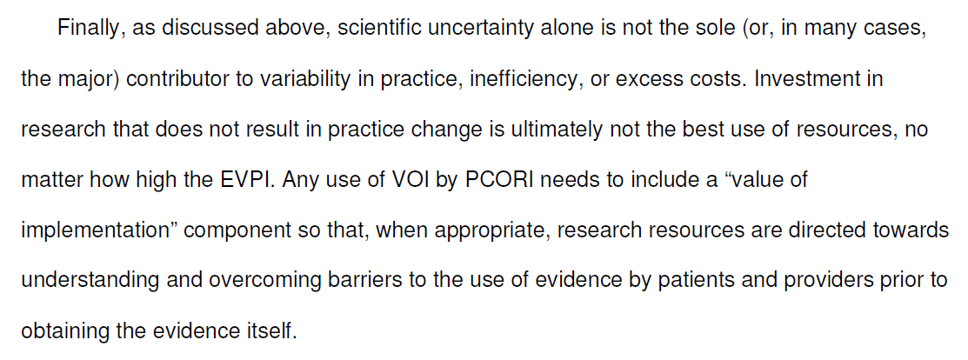
VI. Recommendations

Slide 39
Value?
δ_{Current}
δ_{New}

Slide 40
Questions/Discussion

